Slide 1
Photovoltaic (PV) Energy A General Overview
MSc David Martínez Biro

Slide 2
Content
How does PV energy work?
PV Systems
Advantages and Drawbacks
Developed and Emerging Technologies
Efficiency Progress
Energy Pay Back Time
Market Tendencies

Slide 3
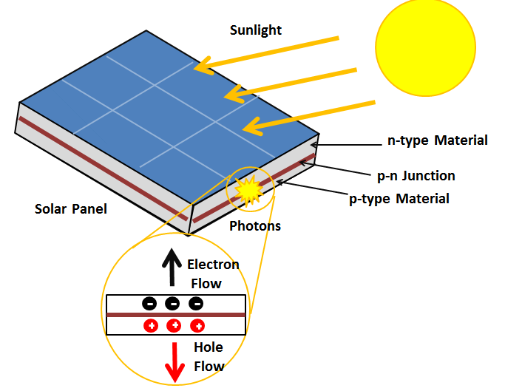
How does it work?
Photovoltaic Effect
(1)

Slide 4
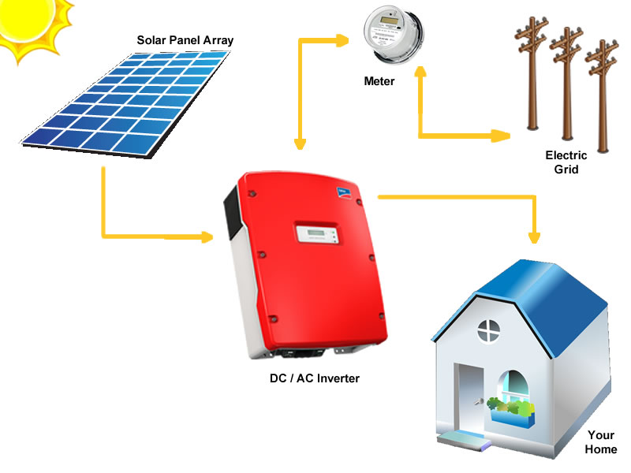
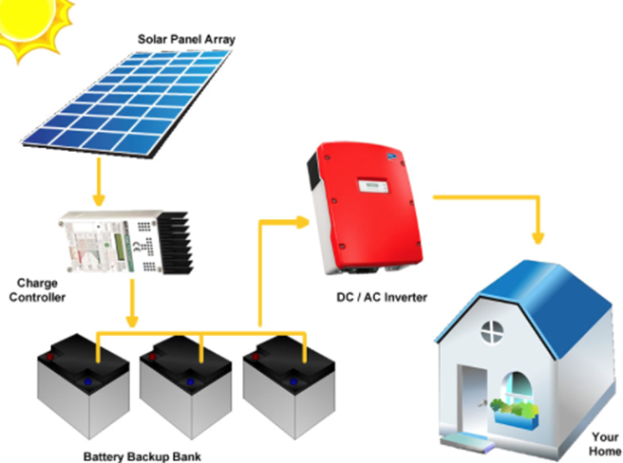
PV System (On-grid/Off-grid)
(2)
Notes:
Mention how net metering works in Mexico

Slide 5
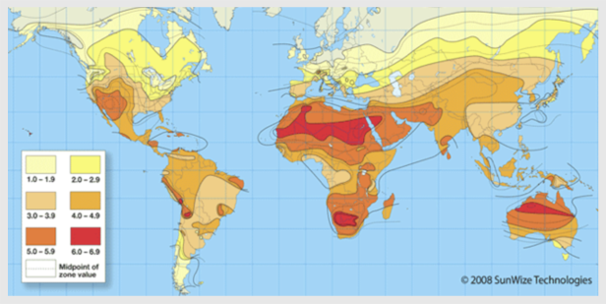
Advantages
Available almost anywhere
Electric energy direct conversion
Low (almost negligible) maintenance
No mechanical moving parts
Silent (+ in urban areas)
Coincides with cooling needs
Government financial incentives
Easy rooftop/ground installation
Predictable production
(3)

Slide 6
Drawbacks
Variable production (day/night and seasonal)
Less reliable
PV systems require DC to AC inverters
Large area
Low efficiency compared to other energy production systems

Slide 7
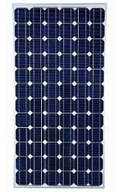
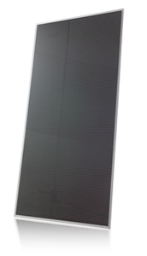
Developed Technologies
First generation:
Crystalline Silicon ~ 90% market share
Second generation
Thin Film ~ 10% market share
(4)

Slide 8
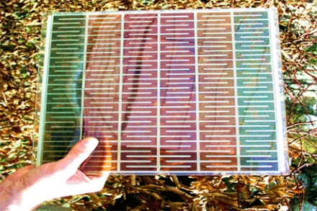
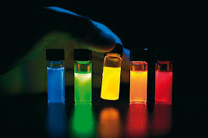
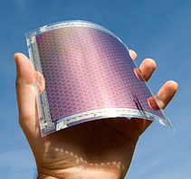
Emerging Technologies (Third Generation)
Dye-Sensitized
Quantum dots
Perovskite
Organic
(5)

Slide 9
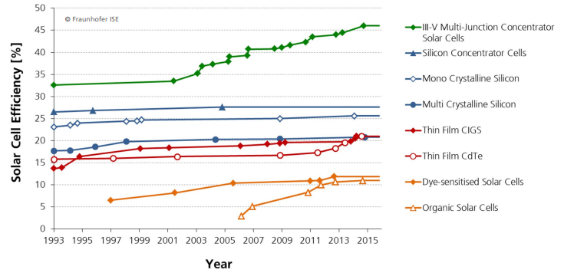
Efficiencies Progress
(6)

Slide 10
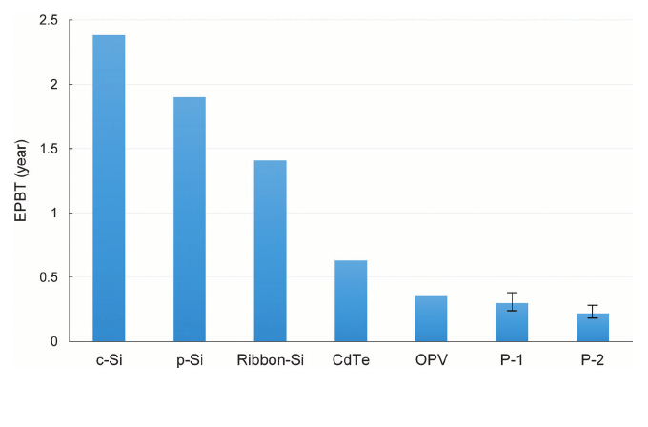
Energy Payback Time
PV systems have a 25 years lifespan
(7)

Slide 11
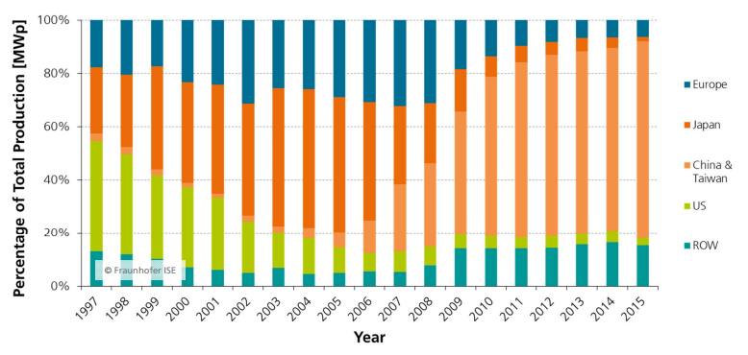
Market Tendencies
PV module production by region
(8)

Slide 12
Global cumulative PV installation by region
(8)

Slide 13
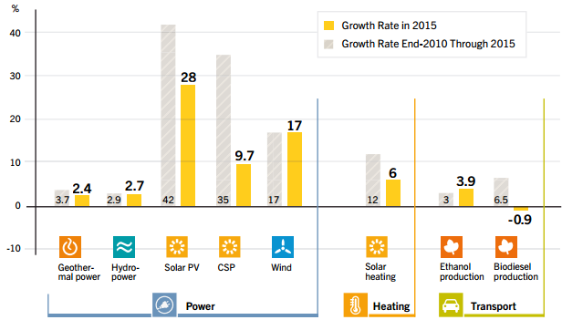
Annual Growth Rates of Renewable Energy Capacity
(9)

Slide 14
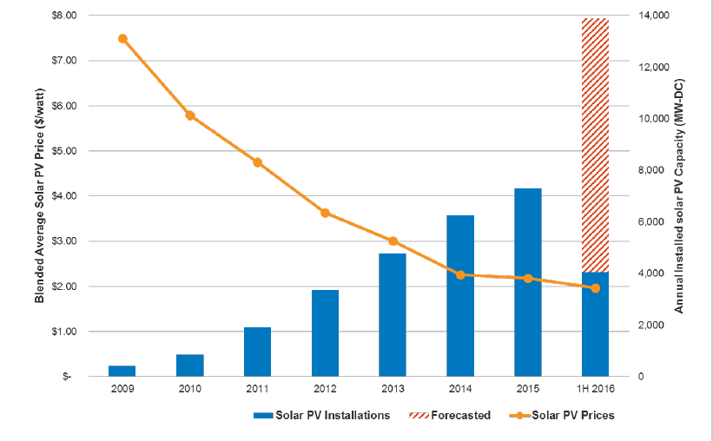
Price vs Capacity Installed per Year
(10)

Slide 15
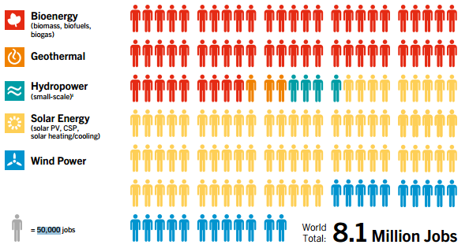
Jobs in Renewables
(9)
Notes:
Only around 200k from North America. And 194 are from the US.
Mexico not producint significan amounts

Slide 16
Thank you for your attention

Slide 17
References
http://energyeducation.ca/encyclopedia/Photovoltaic_effect
http://www.hinren.com/solar-energy-solutions/solar-pv-solutions/grid-interactive-srtpv-system/
http://www.crses.sun.ac.za/technologies-solar
http://www.borgenergy.com/monocrystalline-solar-panel/
6. Solar Cell Efficiency Progress, 2016
7. https://www.researchgate.net/figure/275364910_fig9_Fig-9-Energy-payback-time-for-seven-PV-modules-P-1-represents-the-TiO-2-perovskite
PSG AG, 2016
http://www.ren21.net/wp-content/uploads/2016/06/GSR_2016_Full_Report.pdf
GTM Research, SEIA, 2016

