Slide 1
Nuclear’s Role in Advancing Clean and Secure Energy
Advancing Sustainable Clean Energy in North America
Commission for Environmental Cooperation Joint Public Advisory Committee
November 7, 2016
Dale Austin
Manager, Government Relations

Slide 2
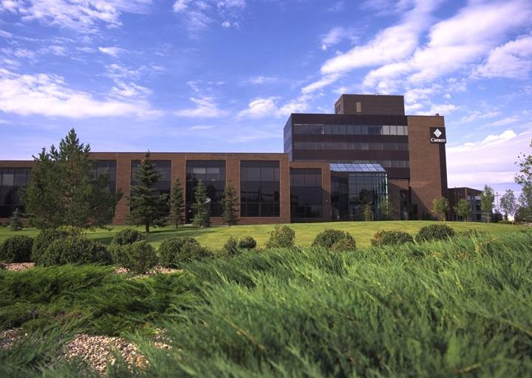
About Cameco
One of the world’s largest uranium producers
  Account for ~18% of total world uranium production
  Our uranium powers 1 in every 19 homes in the US, 1 in 10 in Canada
Corporate head office in Saskatoon, Saskatchewan
  ~4,000 North American employees and contractors
Canada’s largest industrial employer of Aboriginal people
Mines in Saskatchewan, US and Kazakhstan
Refining, conversion and manufacturing facilities in Ontario

Slide 3
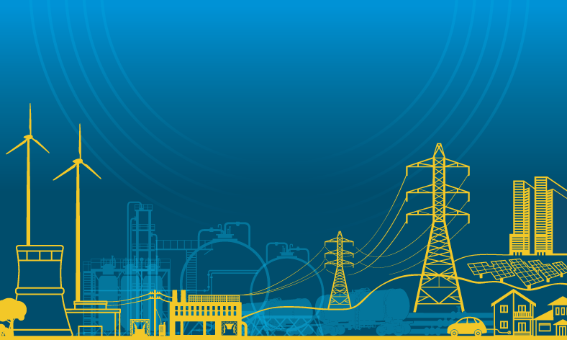
Getting to 50% Clean Power by 2025 – More Nuclear
Global shift to lower carbon energy
Renewable energy in demand
Nuclear technology is proven
Economic benefits are clear
Waste solutions are proven
Policy makers & influencers should renew consideration

Slide 4





Canada’s Nuclear Industry: A Strategic Asset
Contributes to Canada’s and North America’s economic, environmental and social goals
Provides 16% of Canada’s grid-delivered electricity – 60% here in Ontario
Generates
zero GHGs
Opportunity for growth in international nuclear marketplace – technology; fuels; components; expertise
Notes:
Additional point:
** Community consent: nuclear power generation facilities are already in host communities that welcome them, including the local First Nations communities.

Slide 5
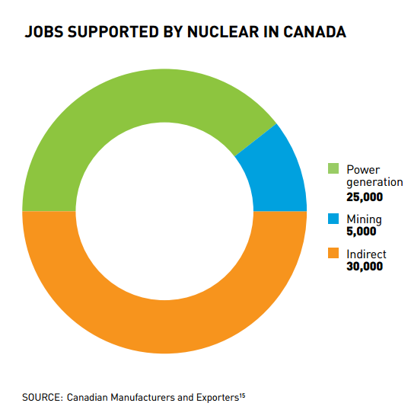
Economy
60,000 jobs (direct & indirect):
  Highly skilled and knowledge-based
Central to Canada’s innovation system:
  Links universities, research facilities, utilities, advanced manufacturing, health care
Greater than a $5B industry
  supports medicine, materials science, advanced manufacturing, food safety, and energy production
Affordability
  One of the most affordable power sources, more so if carbon pricing is taken into account

Slide 6
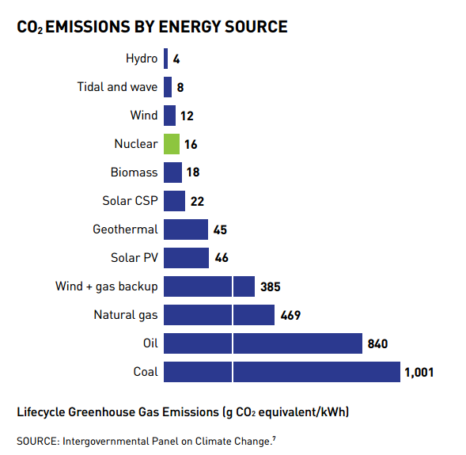
Environment
Key instrument for climate stabilization:
  Zero GHG emissions during operation
  Lifecycle basis: compares favourably to hydro, wind and solar
  Health benefit: No more smog days
Nuclear waste:
  Only energy industry able to account fully for all waste
  Spent fuel safely stored
  Future waste-management liabilities already fully funded by generators
Notes:
- Additional note re comparison of waste management of other energy industries

Slide 7
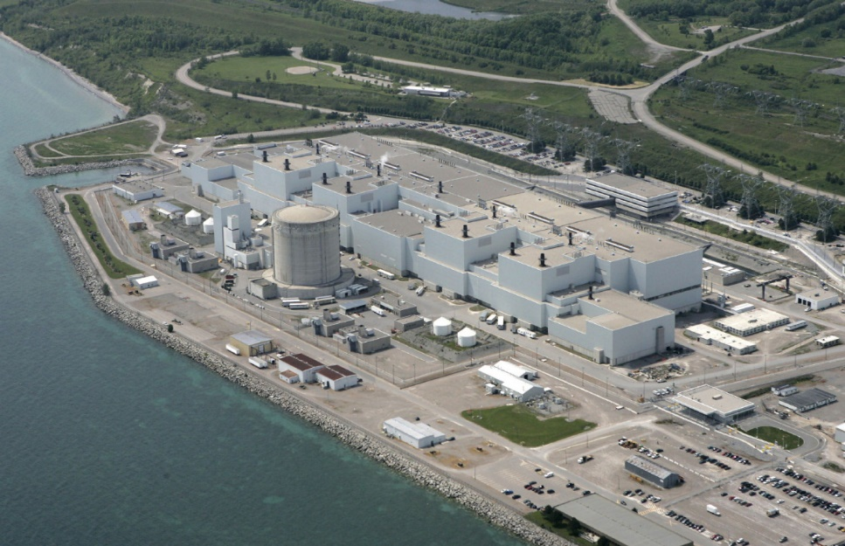
What we ask of Policy Makers –
A Fresh Evaluation
All energy sources have impacts
A 360 analysis of nuclear shows:
  Low emissions
  Tiny footprint
  Manages waste successfully
  Catalyzes technology advances
  Can solve northern/remote challenges such as clean energy infrastructure, water treatment, food production

Slide 8

Low-Carbon Electricity Supports Other Clean and Resilient Systems
Decarbonizing the transport grid
Decarbonizing buildings
Information & communications
Medicine and public health
The power system must remain robust, resilient, accessible and affordable for everything else to work

Slide 9
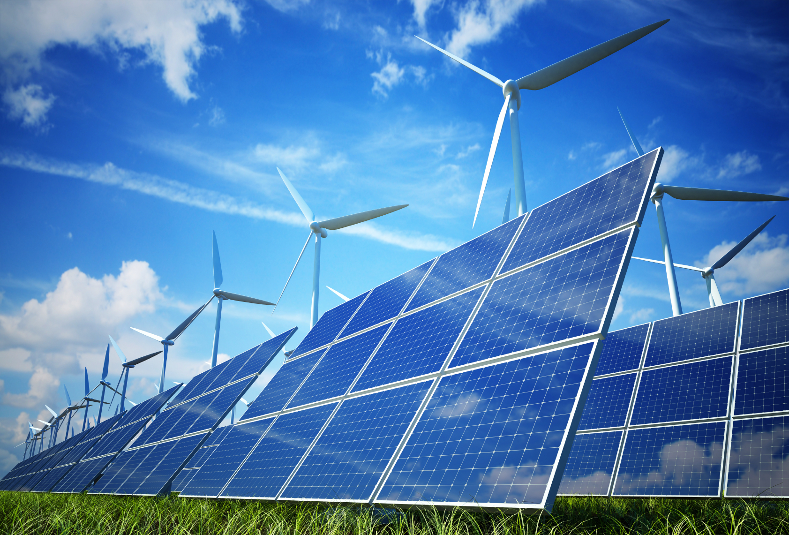
Innovation and Progress
Nuclear anchors a resilient, sustainable grid & enables renewable technologies
Supplies ultra-low-GHG base load
  Displace coal
  Anchor the testing, proving & scaling up of wind and solar
  Anchor experiments with distributed generation & smart grid technologies

Slide 10
Nuclear Power: A Key Contributor to a Low-Carbon Energy Future

Slide 11

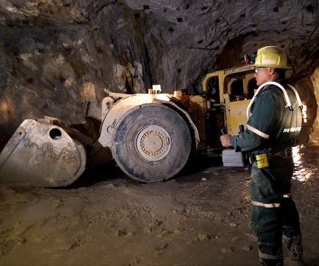

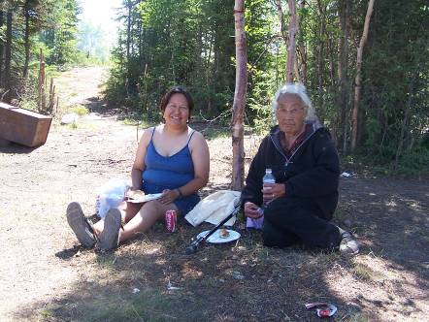

Marci Cho – Thank you - Teniki

