Slide 1
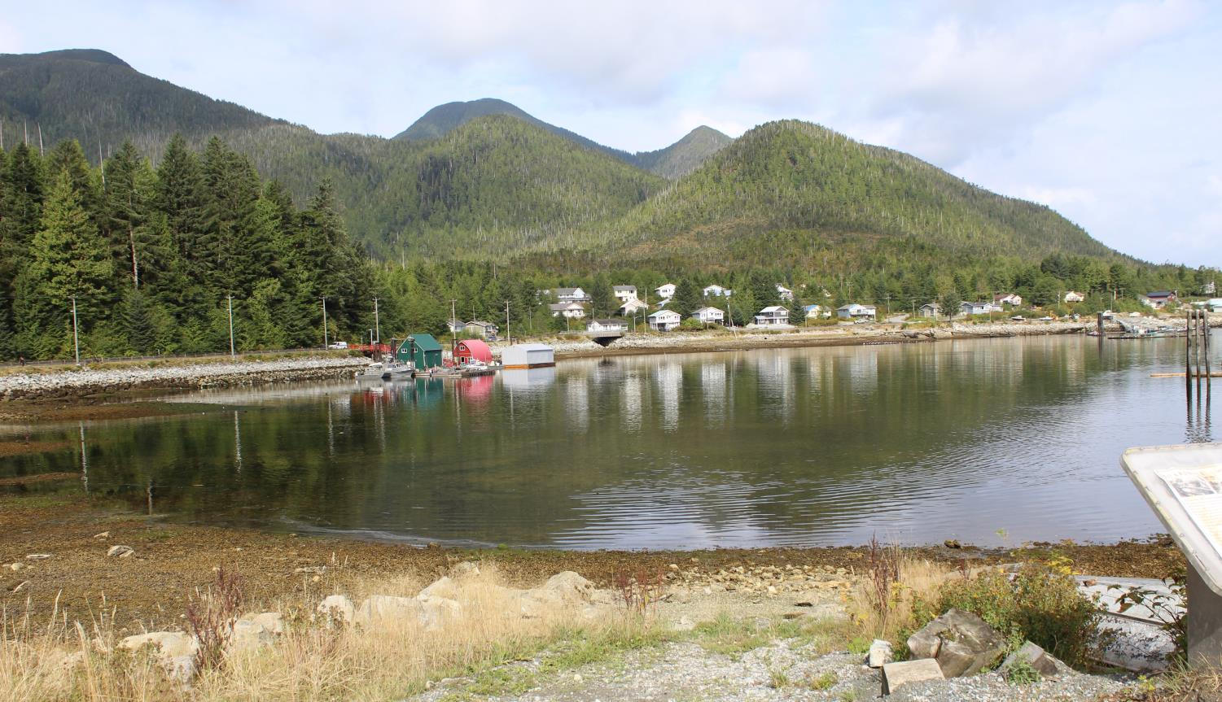

Sea-Level Rise & Coastal Food Security
Fostering Resilience through Indigenous Innovation
@Zafar_Adeel_

Slide 2
Global Trends of Warming

Slide 3
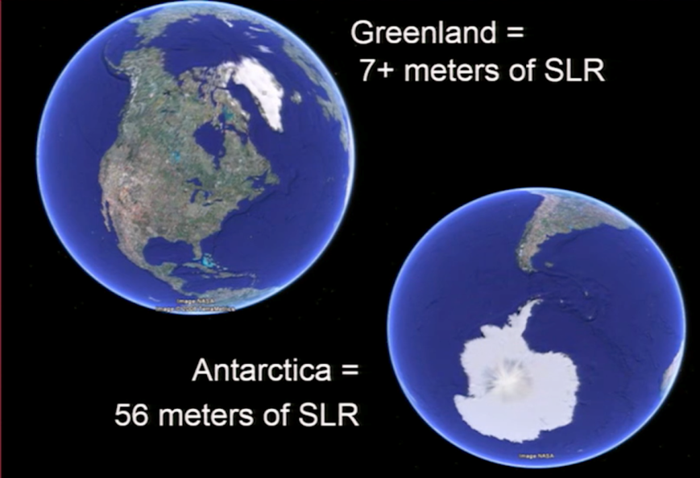
The Real Risk: Melting Glaciers on Land
Source: “High Tide on Main Street” by John Englander (2016)

Slide 4
Impact on Coastal Communities

Slide 5
SLR Potential Impacts on Florida
Source: Earth Observatory, NASA (Feb 2000)

Slide 6
First Nations’ Traditions of a Great Flood
Threats to salmon habitat
Disruption of food production systems
Disruption of economic activities (e.g., ecotourism)

Slide 7
How fast will sea level rise?
How high will it be?

Slide 8
Slow, Gradual Change….
….. Interspersed with Violent Interludes

Slide 9
What Can We Do: Exploring Low Carbon Resilience
Source: Winkelman et al., 2017 (SFU ACT)

Slide 10
Re-Engineering Our Thinking – Low Carbon Resilience

Slide 11
Indigenous Food Security – Resilience & Sustainability
Context for sustainability:
  Coping with emerging threats to ecosystems
  Indigenous self determination (per UNDRIP)
  Prior informed consent as a key principle
  Indigenous perspectives on environment versus activism
Consideration of long-term health and wellbeing
  Food security as a key ingredient
  Impact of cultural threats
Incorporation of Traditional Ecological Knowledge (TEK)
  Some loss in fidelity in food security due to colonial history
  Adverse health and wellbeing outcomes
Accommodating tremendous diversity in indigenous perspectives
  Indigenous communities not to be treated as a monolith

Slide 12
Common Challenge, Common Solutions
Explore the interface between traditional knowledge & contemporary challenges ►► innovative solutions
  Mitigation through energy innovations ►► Clean energy and grid independence
  Adaptation through community-engaged food security solutions
Engage communities in action-oriented research
  Incorporation of traditional food knowledge (as part of TEK)
Build capacity at various levels
Facilitate informed policymaking based on scientific evidence
  Provide a safe space for dialogue on food security and green economy

Slide 13

N-EAT Conceptual design
Focused on BC First Nations communities
Aims to:
  enhance communities’ access to sustainable, organic foods
  ensure sustainable access to water and energy
  build resilience against impacts of climate change
Builds on and expands local and traditional knowledge
Leads to the use of best practices

