Slide 1
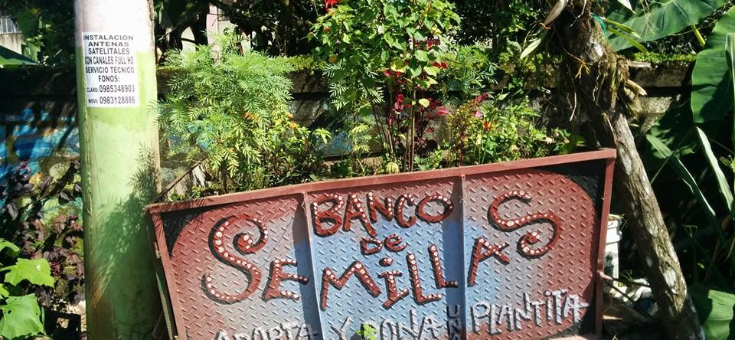
Food Security and Resilience in North American Communities
Jennifer Temmer, IISD
June 24, 2019

Slide 2
A Resilient Food System
“A resilient urban food system is one in which citizens are food secure; that is, they have reliable access to healthy, affordable and culturally appropriate food…a resilient food system is also food sovereign, meaning that people have decision-making power over where their food comes from.”
Building a Climate-Resilient City: Agriculture and food security
(Temmer, 2016)
Notes:
Resilience: The ability of a system to withstand, respond to, and adapt more readily to shocks and stresses to bounce back stronger after tough times and live better in good times
Food secure- reliable access to healthy, affordable and culturally appropriate food
Food sovereign- decision-making power over where their food comes from and how it was produced;
So, a resilient food system is one whose citizens are food secure and food sovereign and able to withstand, respond to and adapt to shocks and stresses and to bounce back after tough time and live better in good times.
This is important regardless of where there is an extreme weather event, normal meteorological occurrences or otherwise.

Slide 3
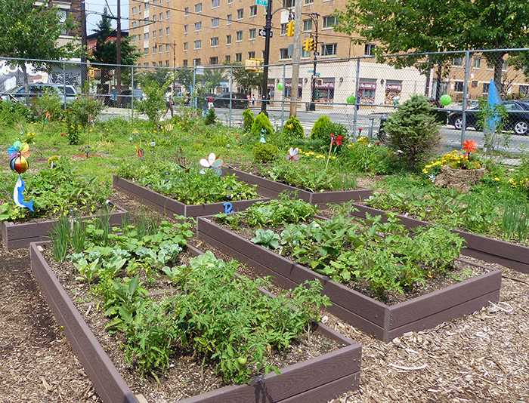
Growing a Resilient Food System
Strengthening the local food system increases resilience to supply shocks from climate change impacts on international supply chains.
Identify areas where resilient characteristics can be bolstered within the system
  Build robustness: physical assets built to withhold high-impact climatic events
  Promote redundancy: spare capacity
  Encourage resourcefulness: citizens are aware and able to adapt
Notes:
Inclusiveness- include broad views and consultation
Integrated- developing networks between systems instead of silos
Flexibility- willingness to adopt alternative strategies as needed
Reflexiveness –learning from the past to inform the future
While we talk about resilient food systems in the context of extreme weather events I think that it is important to point out that the vast majority of cities across North America, and around the world have pockets of food insecurity. By creating policies, programs and support systems to improve food security for vulnerable citizens in every day situations, it will help to significantly reduce the amount of effort and resources needed to ensure people have access to food during times of crisis.
Strengthening the local food system increases resilience to supply shocks from climate change impacts on international and regional supply chains.
In many communities we rely heavily on grocery stores to purchase our food. This convenience has removed us from our connection to the land and those who grow our food. It has also made us increasingly vulnerable in terms of accessing food if our supply is jeopardized.
By diversifying our food supply chains and food sources and encouraging purchasing buying, selling and distributing food through channels outside of grocery stores citizens have a greater ability to remain food secure and sovereign in the face of climate change and extreme weather events.
Strengthening the local food system means increasing its resiliency at multiple access points to ensure there are multiple choices to meet the needs and price points of the richest and poorest households. Yes on multiple access points, we also probably also multiple levels as there are things that city can do, province, country etc, - and the robustness also means that these levels are harmonized (they fit together as pieces of a puzzle)

Slide 4
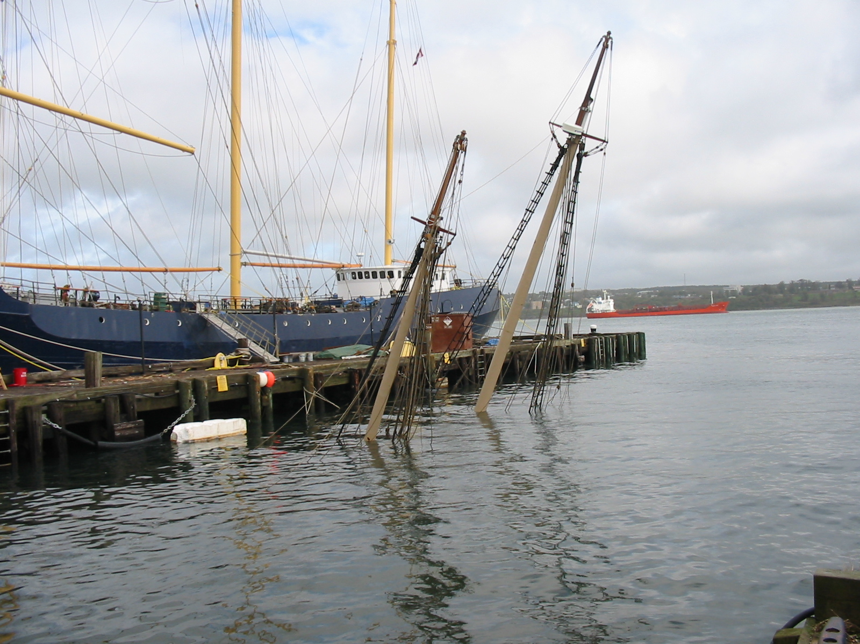
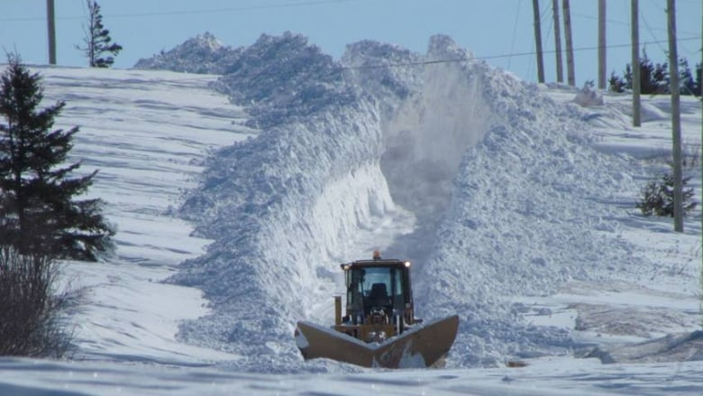
Halifax, Canada
Hurricane Juan: September 29, 2003
“White Juan”: February 17-23, 2004
Notes:
Hurricane Juan:
Class 2 hurricane 160km/hr winds.
Impacted entire region especially NS and PEI
8 fatalities and over $300 million in damage
damage to trees and vegetation – especially Point Pleasant park- 85% of trees removed
Biggest, but was actually one of 6 tropical storms in the season
Juan was retired in 2004
White Juan:
nor’easter- blizzard
5 months later
5cm/hr for 12hrs with strong winds- 95.5 cm snow!
Pushing snow into the harbor

Slide 5
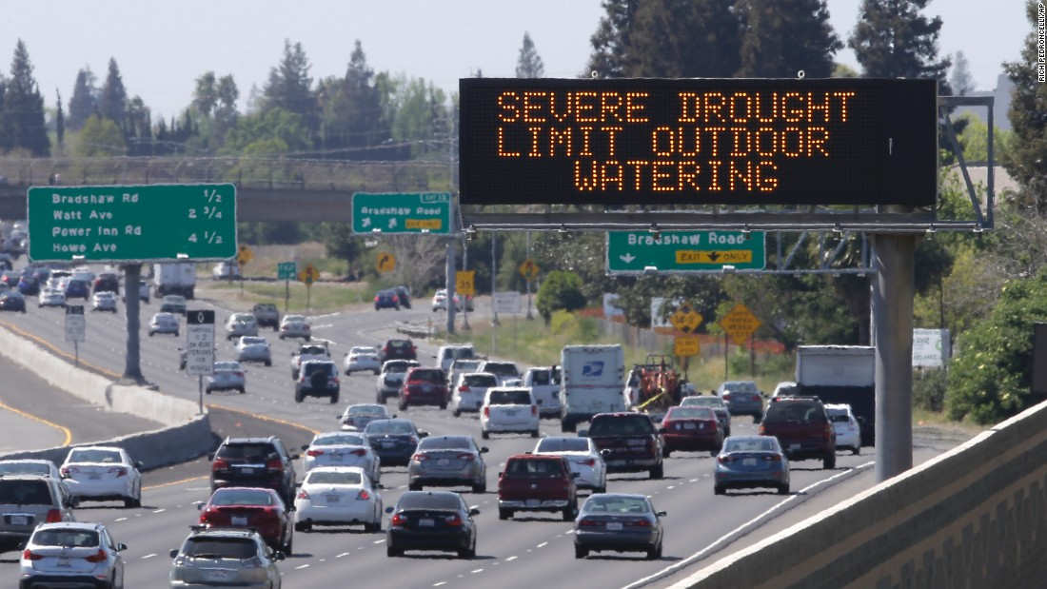
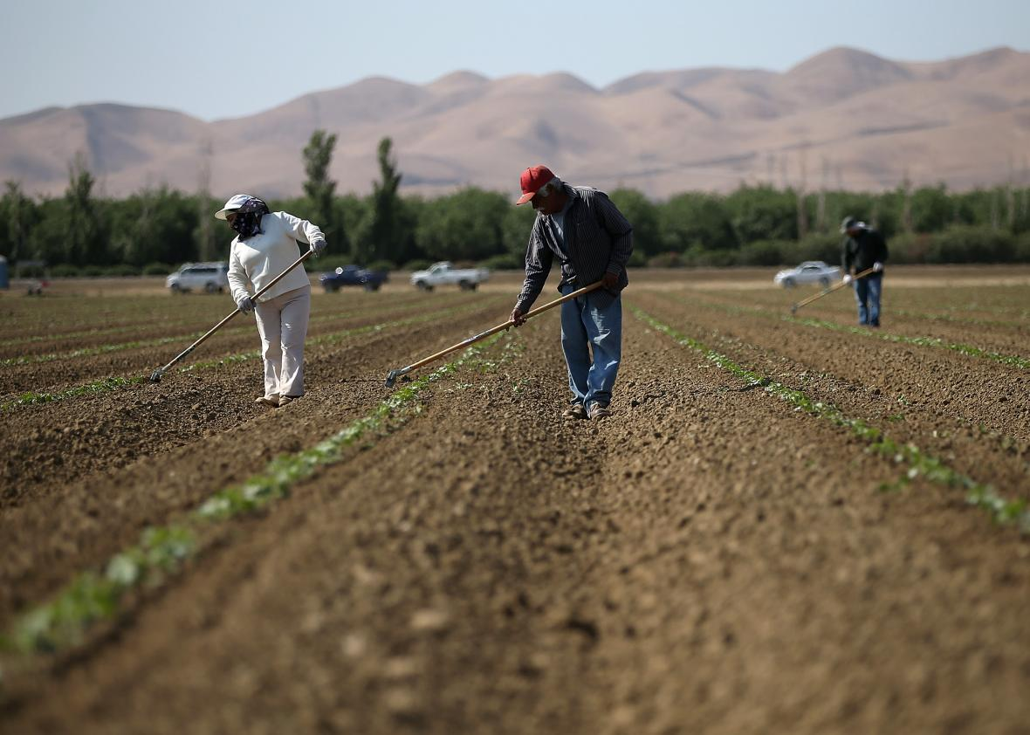
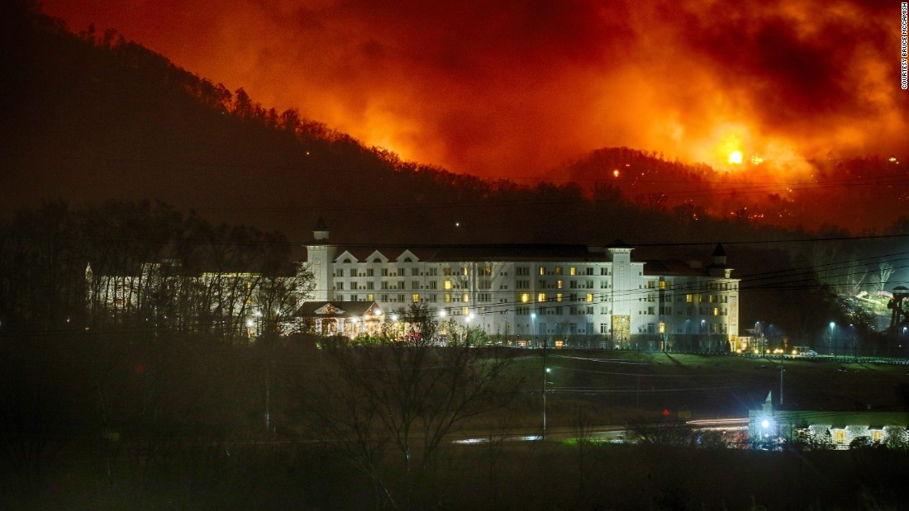
California, USA
Drought: 2011-2016
Notes:
California is the largest fruit and vegetable producing region in the US and has significant dairy production as well
California’s drought
Lasted 5 years
Long lasting impacts- the
Thomas fire in 2017
-118,000 acres farm land in Ventura County impacted and ½ the harvested acreage impacted- the estimate was an 80% lofss of the avocado crop for 2018-19
Camp Fire in 2018
-range land losses of 30,000-40,000 acres causing massive damage to ranches, barns and displacing animals
-chronic reduced yields

Slide 6
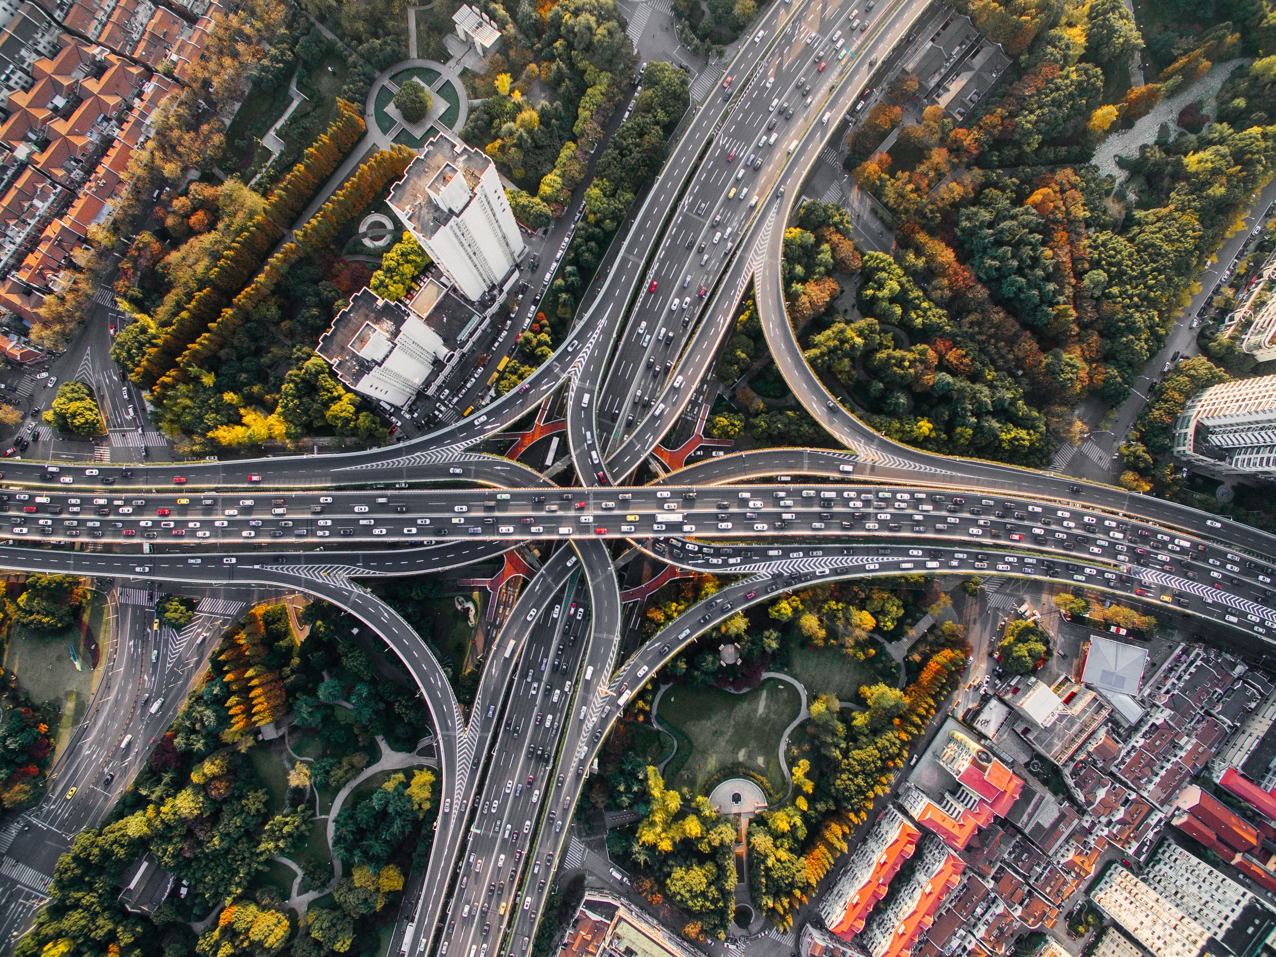
Growing a Resilient Food System
Vulnerable points in agriculture and food sectors in the context of extreme weather events
Supporting Infrastructure Systems
Transportation
  Regional routes needed to get products to market
  Urban transit systems shut down
Energy
  Power outages caused spoilage
  Insufficient back up generators
Water
  Competing interests divert water from agriculture
Notes:
Consequences
Transportation:
Impacts both international and regional supply routes making it difficult to get food in (in the case of Halifax) and even out, as with California.
Urban systems shut down making it even more difficult for citizens to reach stores to access food
Energy:
Power outages limit access to food as grocery stores need to close to preserve their current food supply
Cause massive spoilage both commercially (stores, restaurants, processors, farms) and individually in houses
Water:
- Most important in drought conditions as water is diverted for other uses. Agriculture needs a huge source of water regardless of the technologies used to reduce consumption. Without it, we really can’t grow food.

Slide 7
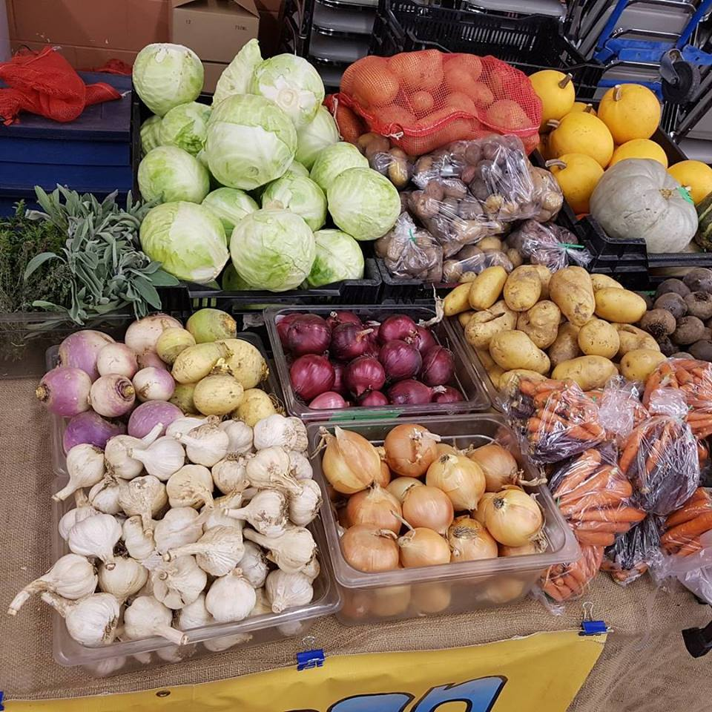
Growing a Resilient Food System
Vulnerable points in agriculture and food sectors in the context of extreme weather events
Markets
Short term instability
Crop failure
Food and gas prices spike
Agriculture Production
Access to inputs
Financing and insurance
Alternative production methods
Notes:
Markets
Crises cause short term instability in the market which can impact employment and place more stress on household incomes
Crises also cause panic among citizens who are not prepared -this increases demand, while supply is uncertain typically we see increased food and gas prices at these times.
Production
Extreme weather events cause different impacts on producers depending on which part of the growing cycle they are in.
in the north, winter blizzards may not have an impact on production, but it can damage buildings and equipment and put animal production at high risk- we hear often about deaths of large numbers of cattle caught in spring snow storms in the mid-west.
Extreme weather such as flooding or drought during seeding or harvest can also have massive negative impacts
1. farmers are unable to seed their land they cannot make a profit and they cannot get food to market- depending on the timing this can be compensated for by planting alternate crops with shorter growing seasons, but come harvest time if the crop is lost the farmer takes the hit.
With every frequent extreme weather events, insurance and access to financing to make improvements and invest in technologies to make farms more resilient is essential. The question is around premiums however- in Manitoba, insurance is based on an Olympic, or 5 year growing average so every bad year a farmer has, the smaller the pay out will be.
Alternative methods of production become more popular, enabling food to be grown in different mediums and in urban centres. This helps to improve and strengthen food supply chains however systems such as aquaponics and vertical ag are still vulnerable to shocks

Slide 8
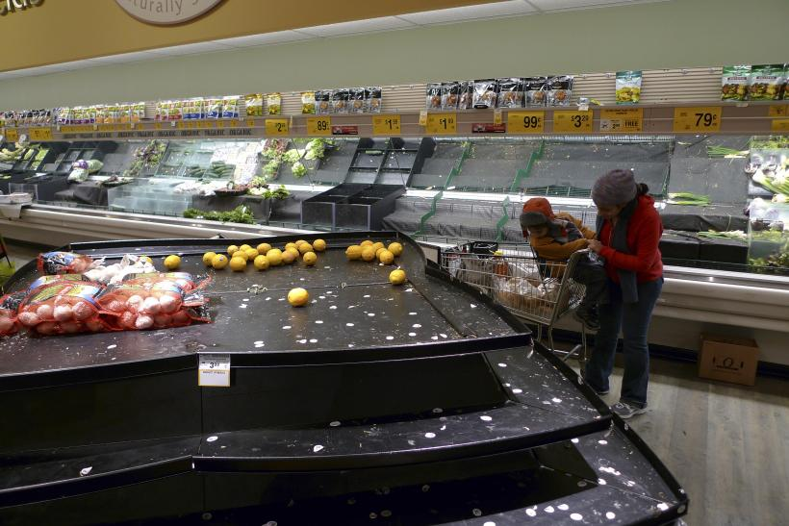
Growing a Resilient Food System
Vulnerable points in agriculture and food sectors in the context of extreme weather events
Citizen Preparedness
Food insecurity increased by crisis
Dependence on single, purchased food source
Insufficient rations
Last minute preparations cause panic
Notes:
Lack of preparedness on the part of citizens causes compounds the situation
Typically crises cause panic and grocery stores can be cleaned out over night- this means those with limited access to reliable transit can be left food insecure
People tend not to store larger quantities of food- due to space, inconvenience or just for lack of interest

Slide 9
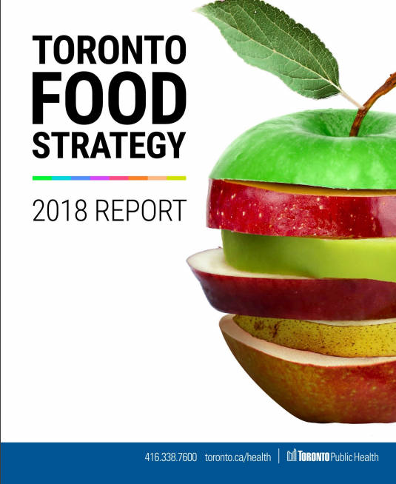
Creating Incentives
Government
Food Strategies and Poverty Reduction Initiatives
Ensuring community responsiveness
Providing access to credit and insurance
Setting regulations on emissions, and nutrient levels
R&D through research and extension for improved ag technologies
Private sector stakeholders
Encourage farmer associations & cooperatives to provide marketing support, price negotiation and direct linkages to consumers
Incentives for farmers to practice conservation agriculture
Notes:
Government
Develop on-going strategies to build more resilient and food secure communities all the time- build in measures that provide guidance for what to do in times of extreme weather events
Education campaigns, support and funds for community responsiveness through encouraging self-sufficiency, local production and sale etc
-provide access to credit and insurance to farmers and processors to implement more sustainable practices
Regulatory mesasures- ie emissions, nutrients
Support R&D for new research and extension to support sustainable practices

Slide 10
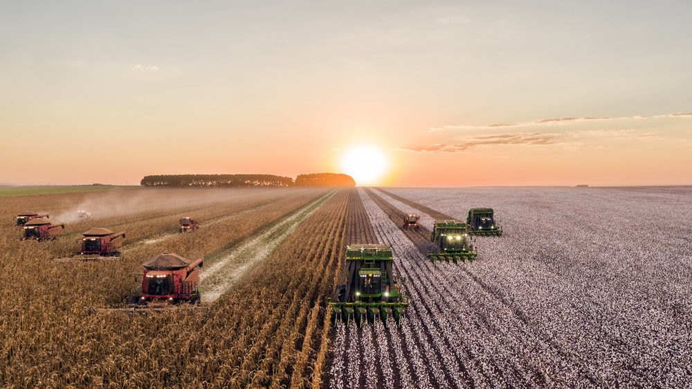
Regional Partnership Opportunities
1. Support for regional agricultural research, extension and biodiversity protection
2. Comprehensive insurance that encourages sustainable and resilient practices
3. Reduction of transboundary red tape for emergency food assistance
4. Centralized disaster relief coordination
Notes:
Ag research and extension- to focus on drought and flood resistant seed varieties, new low-water use crops, centers to store local seed varieties
Remodel insurance policies to encourage farmers to prepare and improve resilience on their farms and use more sustainable farming practices

Slide 11
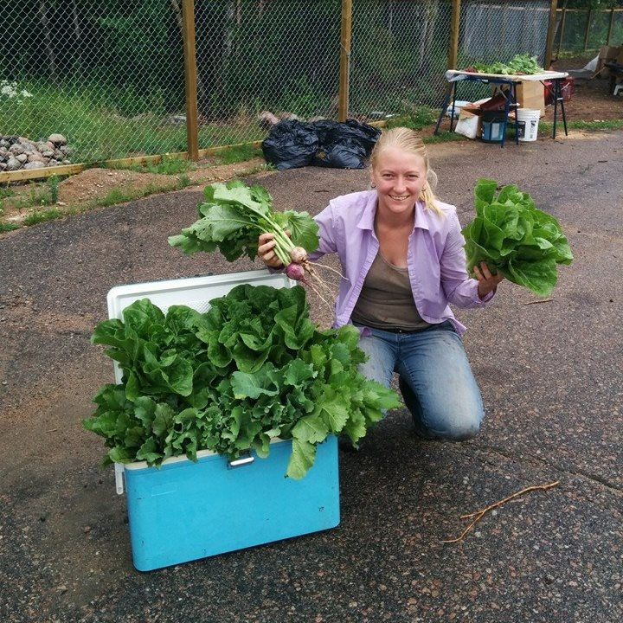
Thank you- Gracias!
Jennifer Temmer
Project Manager
International Institute for Sustainable Development (IISD)
jtemmer@iisd.ca

