Slide 2
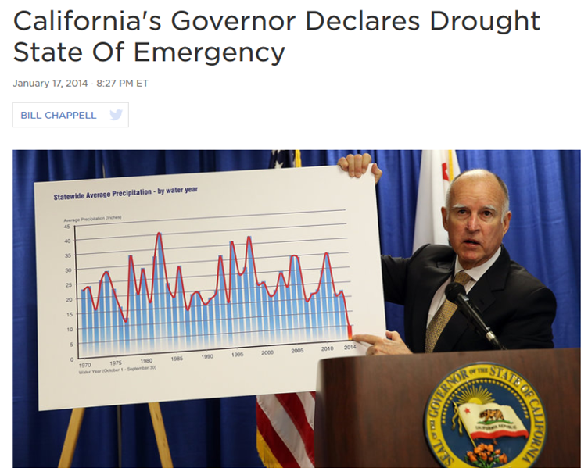
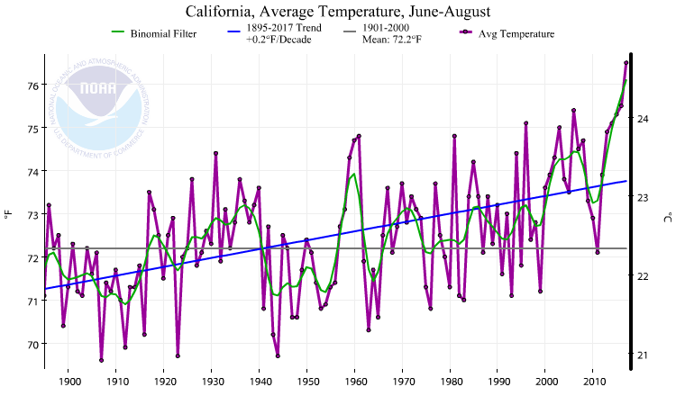
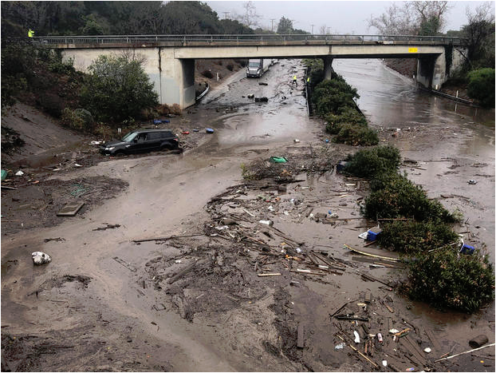
Major Disaster Risk Issues in California
Earthquakes
LA learning from Mexico about earthquake alarms,
i.e., ShakeAlertLA, a mobile ap that sends alerts a few seconds
before an earthquake with a magnitude 5.0 or more
Forest fires
Increasing frequency; beginning to address
factors and strategies, e.g., Camp Fire (Nov. 2018)
Increasing temperatures
Impact on water resources
Declining snowpack—major source of freshwater for
SoCal
Recent water crisis 2014-2017, State-declared water
emergency
Heat waves/Urban heat island
Atmospheric rivers and flooding/mudslides
In the aftermath of fires, catastrophic disasters, e.g.,
Montecito mudslides January 2018 after a series of major
fires
Notes:
Camp Fire, the deadliest fire which killed at least 85 people and destroyed the town of Paradise in northern California last November and burned about 150,000 acres.
A settlement with PG & E of 1B$ was just announced last week—utility’s downed high voltage line in a forested area sparked the fire

Slide 3
4-point Strategy for Reducing Risks to Disasters
Securing Ongoing Production of Local Knowledge on climate change and other risks
Identifying Environmental Justice Priorities
Local Incorporation of Knowledge and EJ Priorities into policy and action;
Establish Informed Supporting Policies at State/Provincial and National Levels

Slide 4
Communities Need Regional/Local Scale Knowledge of Risks
Communities need the right scale projections to address climate change impacts in the coming decades—IPCC relies on global projections
Communities need downscaled regional climate models
Not many urban regions have such models, difficult for local governments to fund, but essential for more responsible disaster risk mitigation and prioritization
This cannot be done just once, but needs periodic updating as climate impacts intensify and modeling efforts are improved

Slide 5
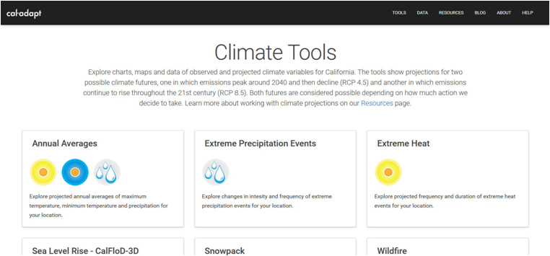
CA’s Climate Change Research
The State funds State university researchers especially the modeling of climate change impacts, e.g., Cal-Adapt.
Cal-Adapt is a web-based set of data bases and projections for climate impacts for different parts of California, including: sea level rise, increase in heating, streamflow, snowpack, drought scenarios
Develops a periodic State-wide/regional climate assessment for the State (4th assessment released in 2018) coordinated by the CEC, Dept. of Natural Resources, and CalEPA.
http://climateassessment.ca.gov/
https://cal-adapt.org/tools/
Notes:
California pretty unique

Slide 6
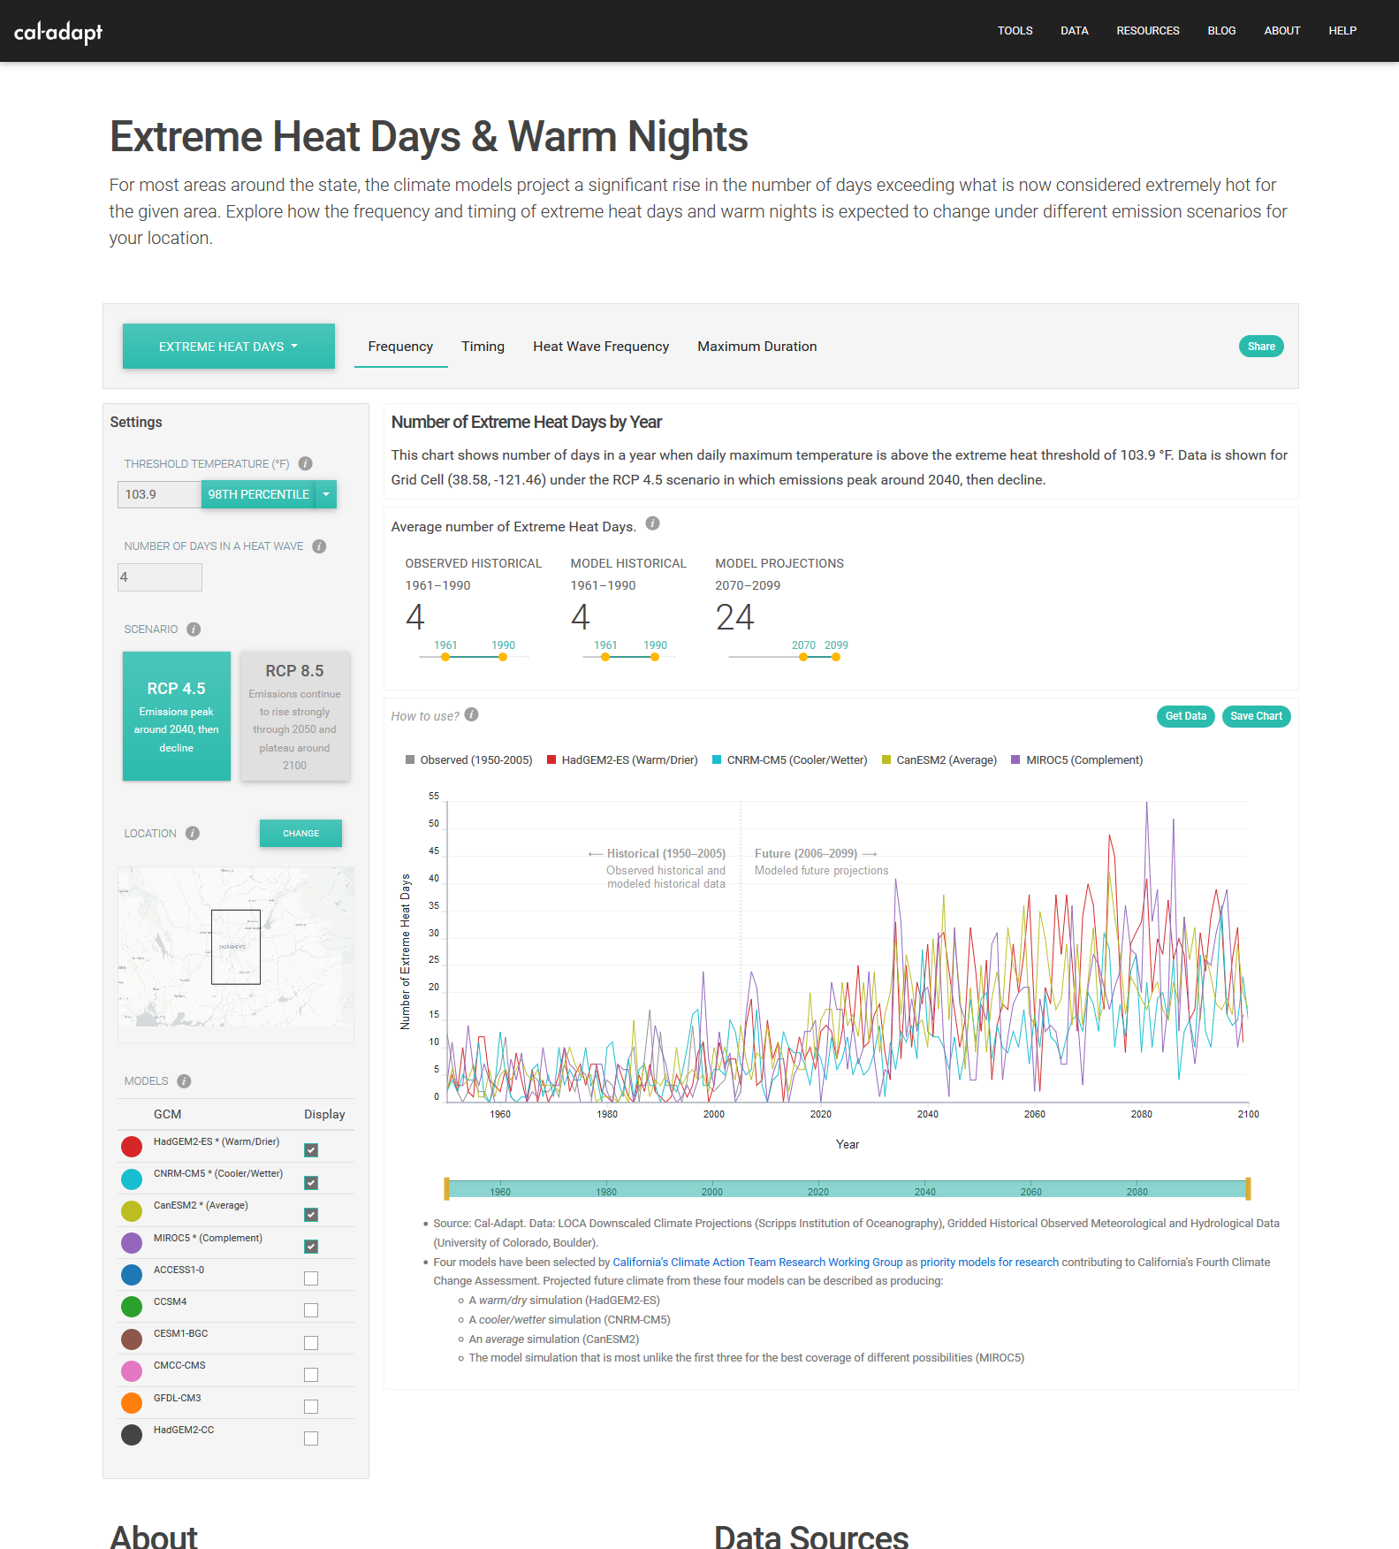
https://cal-adapt.org/tools/extreme-heat/

Slide 7
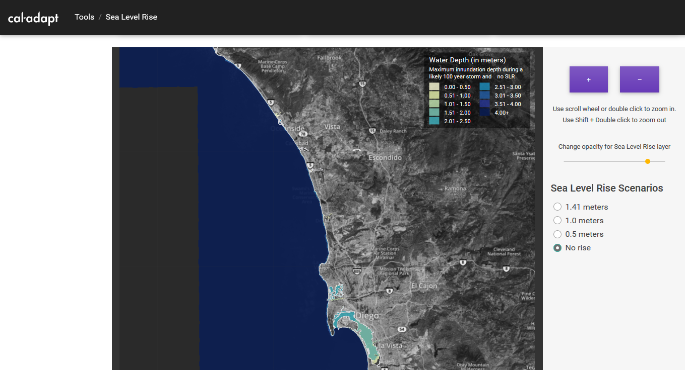
https://cal-adapt.org/tools/slr-calflod-3d/

Slide 8
Example of collaboration between CA and federal US Geological Survey
While CA researchers have developed sea level rise scenarios for coastal California based on various climate models
USGS has been developing a coastal storm surge model: CoSMoS
Very important, because the threat of sea level rise is not just from slowly encroaching seas, but from the periodic coastal storms that can create great damage and loss beyond the immediate areas threatened by rising seas

Slide 9
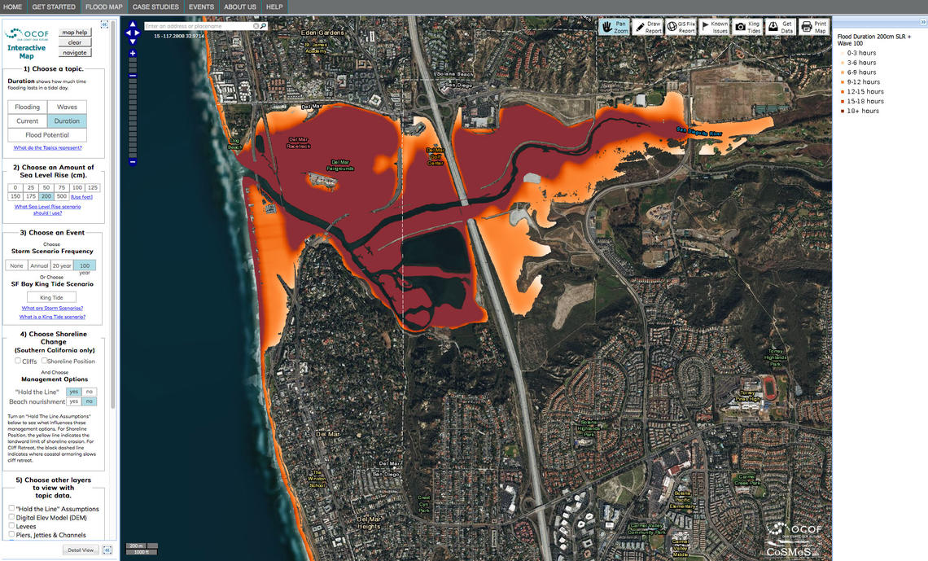
https://www.usgs.gov/media/images/cosmos-model-flood-duration-san-diego
Notes:
Now California coastal planners can rely on models that provide information on sea level rise, as well as storm surges.

Slide 10
How can regions/localities develop such local knowledge?
Too expensive for many local or regional governments to finance such studies, but State or Federal government sponsoring of teams of climate change modelers in each state/regional university system (as in UC system) could develop and update regional downscaled models, modeled on the Agricultural Extension programs that US government funded at the turn of the 20th century in many universities
We need climate modeling and research cooperative extensions in state universities that develop and revise regional climate models and work cooperatively with local and regional/state/federal governments to develop and inform best practices aimed at reducing risk and improving resilience to natural disasters and climate change impacts
While farmers have been the clients of farm cooperative extension programs in universities, local communities and governments would be the clients for disaster risk extension cooperatives
Notes:
In the United States, the Hatch Act of 1887 established a system of agricultural experiment stations in conjunction with each state's land-grant university, and the Smith-Lever Act of 1914 created a system of cooperative extension to be operated by those universities in order to inform people about current developments in agriculture, home economics, and related subjects.

Slide 11
In an Era of Climate Change, Incorporate Best Knowledge into Decision-Making
Once communities can rely on the best knowledge of environmental risks appropriate to their scale, they need to incorporate such knowledge into local and regional decisions on a periodic, ongoing basis (because such knowledge is evolving).
A good initial example of this is how NYC after Hurricane Sandy institutionalized how to incorporate the best knowledge available on climate change on an ongoing basis:
City Council passed Local Law 42 establishing the New York City Panel on Climate Change (NPCC) as an ongoing body to provide advice to the City on climate change, to develop periodic climate projections for the city and their potential impacts at least every three years. This recognizes the importance of projections, and the changing state of both the science as well as the evolving nature of the impacts.
Rosenzweig, C. and W. Solecki. 2015. New York City Panel on Climate Change 2015 Report. Ann. N.Y. Acad. Sci. 1336 (2015) 3–5 C_ 2015 New York Academy of Sciences.

Slide 12
Incorporating Environmental Justice in Disaster Risk Reduction
California, like the EPA, has developed its environmental justice screening tool, CalEnviroScreen, which is a spatial database that identifies environmental harms and vulnerable populations by census tract in the State and ranks each of these in terms of environmental and population vulnerabilities
Subsequent state laws allocate 25% of the proceeds from the state’s Cap and Trade program to reduce vulnerabilities in such communities
These communities, typically poor, burdened by toxic dumps, etc., will likely be more greatly affected by increased UHIE, flooding, etc. Focus on cleaning up these areas should be a priority, federal, state, and local.
Notes:
Census tracts is a neighborhood scale classification, housing from 2,500 to 8,000 people. Most recent report on the use of the funds from cap and trade indicates that about ½ of the funds have been benefitting priority populations identified through CalEnviroScreen.

Slide 13
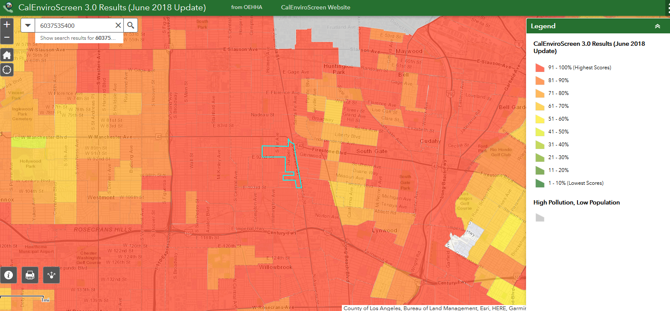
CalEnviroScreen 3.0 example: CT6037535400 in Los Angeles
https://oehha.ca.gov/calenviroscreen/report/calenviroscreen-30
Notes:
Let me show you just a couple of slides to illustrate the value of CalEnviroScreen. Accessible maps that provide information on each of the 8,000 census tracts in the State. Here is census tract 6037535400, in an area in the Southern portion of Los angeles which rates in the top of environmentally burdened areas in the State (Alameda and Firestone). The pollution burden is due to hazardous waste sites, toxic releases, cleanup sites, groundwater threats , and PM2.5, high asthma and cardiovascular disease with an 98% minority population.

Slide 14
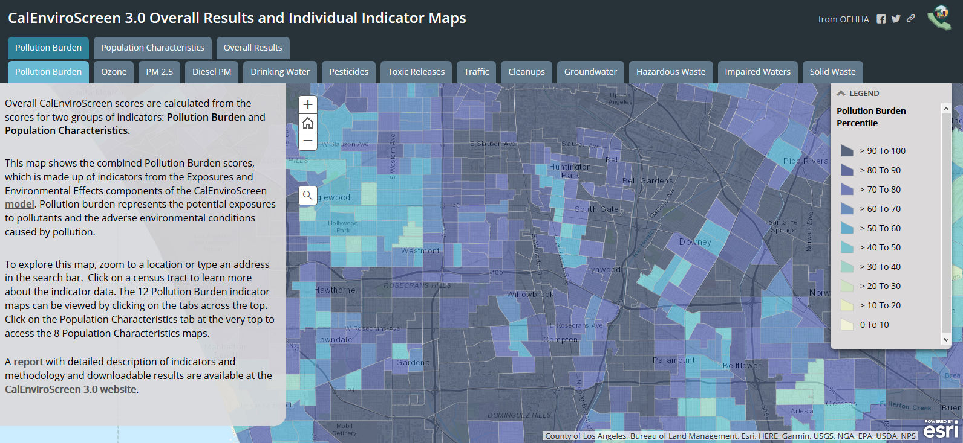
In addition to maps, CalEnviroScreen provides data tables on each environmental and population characteristic for each census tract, making such information widely accessible
Notes:
CalenviroScreen provides specific maps of these different pollutants identified in the tabs as well as various population characteristics

Slide 15
In summary, the CEC can enhance its role in supporting communities to reduce vulnerabilities
By promoting/establishing/funding or identifying funding for University extension services focused on regional natural hazards and climate change vulnerabilities to conduct, and disseminate applied regional research;
By developing or promoting the development of easily accessible tools to identify environmental burdens and vulnerable populations at a neighborhood scale;
By incorporating and prioritizing regional/local knowledge of natural hazards, climate impacts, population vulnerabilities and injustices in local, regional, state and national policies and practices and supporting the financing of such policies.

