Slide 1
Strategies for Trash free seas
Chever X. Voltmer
Director for Plastics Initiatives
Ocean Conservancy
Commission for Environmental Cooperation
June 25, 2019

Slide 2
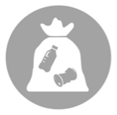
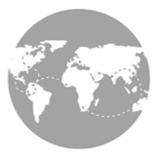
31 Years, 153 Countries, Global Impact
12M Volunteers
220M Pounds of trash
580K kilometers

Slide 3
Science: Building the Foundation
In 2011, Ocean Conservancy recognized that the scientific field of marine debris was young and fragmented.
We initiated an independent scientific working group made up of 2 dozen scientists housed at UC Santa Barbara.
How much plastic debris enters the ocean?
Where does it go?
What are the impacts?

Slide 4
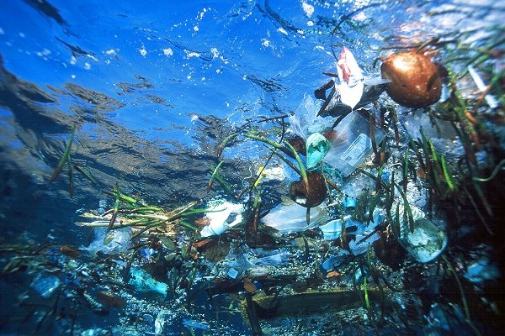
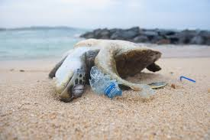
Plastic pollution in the ocean is a well-known challenge, with significant economic, social and environmental implications
8m metric tons of plastic waste are dumped into the ocean each year …
… the equivalent to 20 PET bottles for every person in the world per year
>400 years for a typical PET bottle to decompose in the ocean
$1.3bn cost of ocean plastics to the tourism, fishing and shipping industries
250 million tons of plastic waste could be accumulated in the oceans by 2025 in a BAU scenario
1m marine animals die each year from plastic waste ingestion or entanglement
x
Notes:
Main message:
The impact of plastic pollution is high and spreads across economic, social and environmental.
Sub messages:
Economic: Plastic’s intrinsic material value, loss to fishery and tourism as a business and increased cost of reactionary measures
Social: Livelihoods destroyed, health of informal sector waste workers in the landfills and on community at large
Environment: GHG emission and marine habitat loss

Slide 5
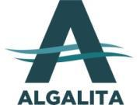
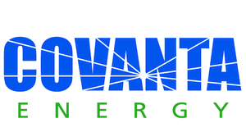
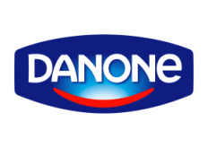
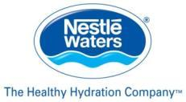
Notes:
Updated to include Berry Plastics and PepsiCo

Slide 6
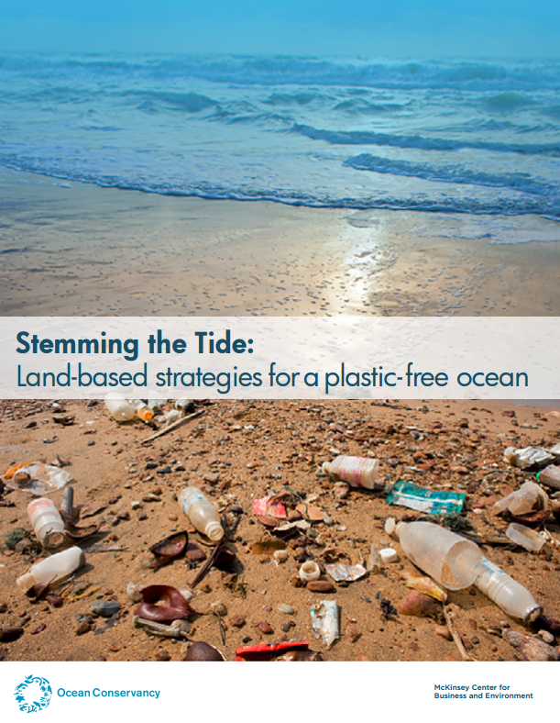
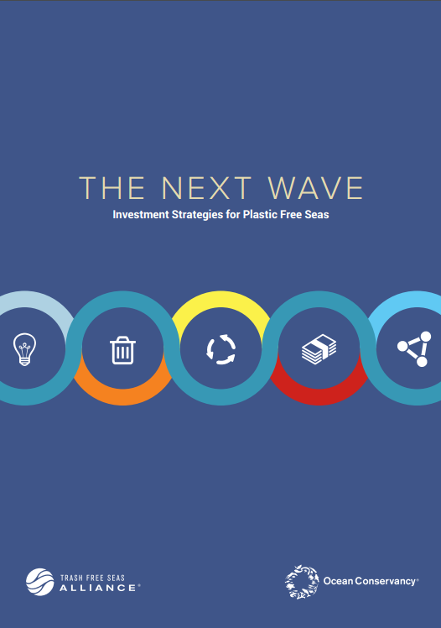
Providing a science-based foundation

Slide 7
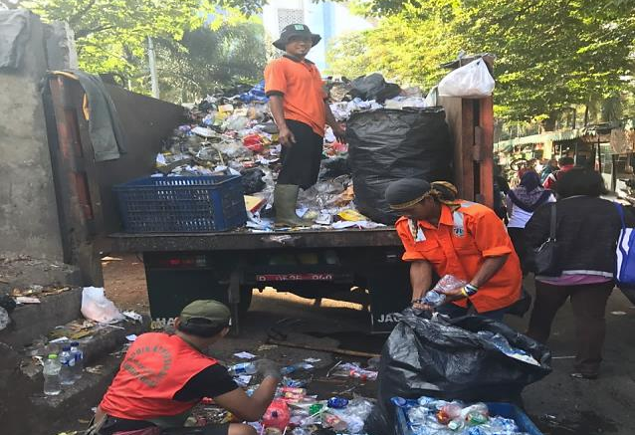
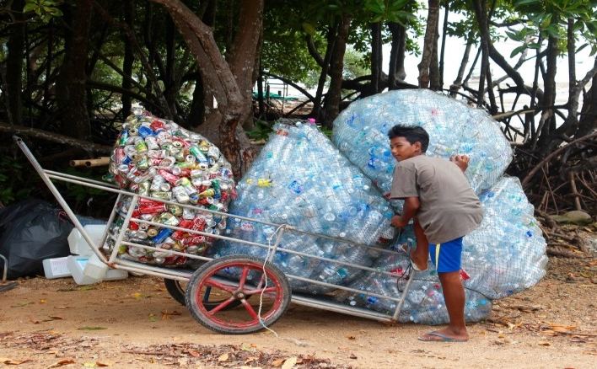
There is a spectrum of solutions
REDUCE PLASTIC IN THE WASTE STREAM
IMPROVE WASTE MANAGEMENT
IMPROVE SOLID WASTE
REDESIGN MATERIALS AND PRODUCTS
INCREASE CAPTURE AND REUSE
CLEAN UP WHAT IS IN THE OCEAN

Slide 9
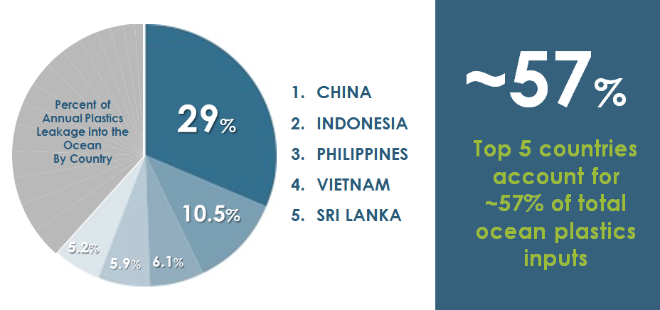
Plastic is geographically concentrated as an unintended consequence of rapid development
SOURCE: Jambeck et al. 2015, Science

Slide 10
Leakage is primarily a result of poor waste management practices vs. total waste generation
Plastic waste generation and management
Million kg/day generated
40
38
Plastic waste generation
Mismanaged plastic waste
35
32
30
25
20
20
15
24
11
9
10
6
5
9
5
0
United States
China
Japan
Indonesia
United Kingdom
Philippines
SOURCE: OC analysis; Jambeck et al. 2015

Slide 11
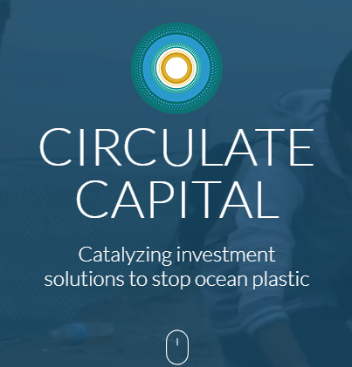
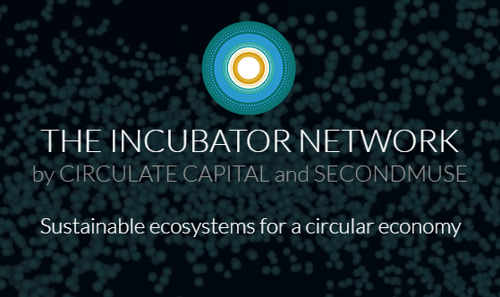
Promoting, Incubating and Investing in Waste Management Solutions to Marine Plastic Waste

Slide 12
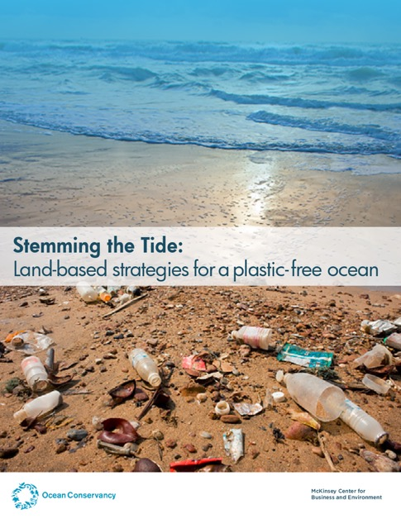
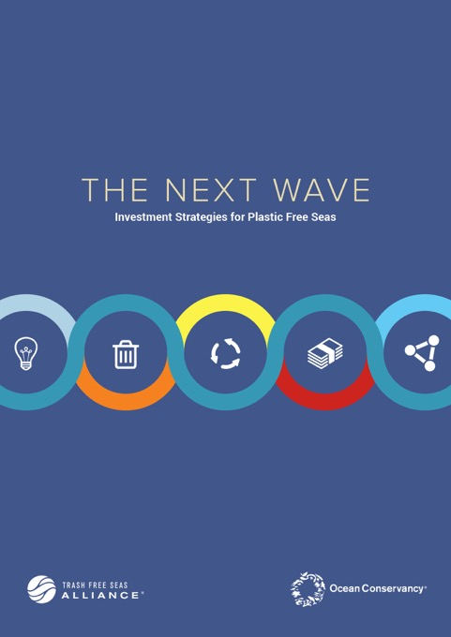
Trash Free Seas Alliance Signature Initiative – Our Journey
Implement & scale phase
2019 -2020
Launch phase
2017-2018
Implement new projects to test and scale effective waste management models
To design and launch the collective effort including:
Building an investment pool and funding mechanism
Advocating governments to prioritize WM
Testing business models in high leakage cities
Enabling phase
2016
Research phase
2015
To understand how to systematically break down the barriers to effective waste management that will ultimately stem the flow of plastic waste into the ocean
To understand how and why plastic waste is leaking into the ocean and evaluate potential prevention approaches

Slide 13
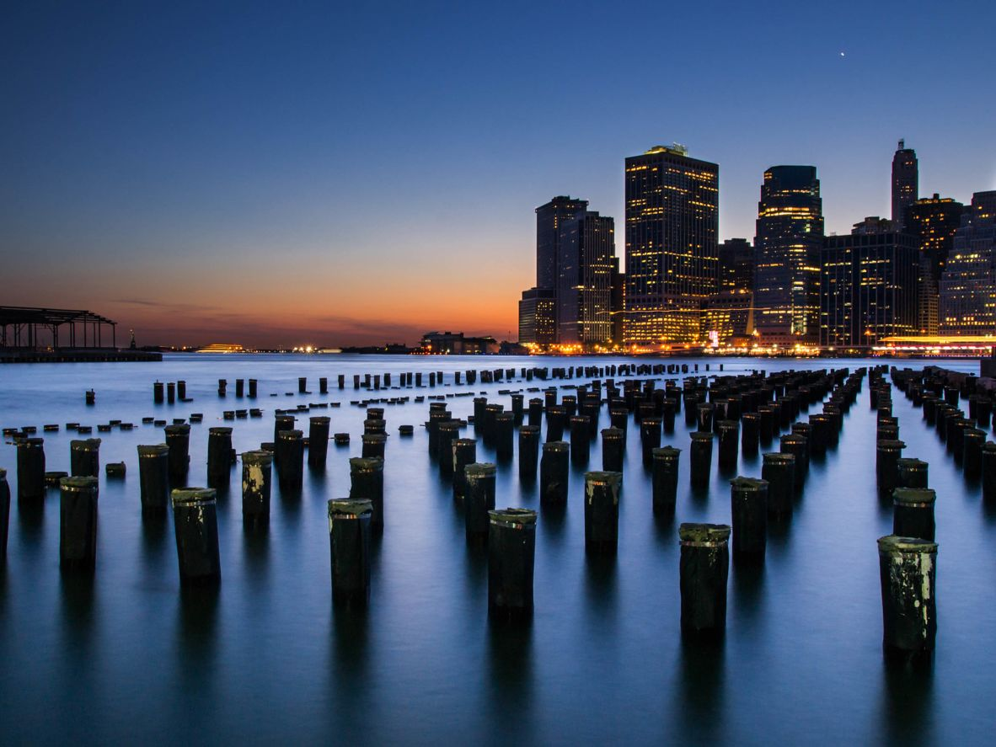
Urban Ocean: Engaging Cities Directly in the Marine Plastic Waste Challenge
Expected outcomes:
A cadre of city champions to tackle marine plastic waste
Launch of a new global platform linking to existing city priorities such as job creation, economic development, and public health
Development of materials for training, capacity building & tools
New public/private partnerships focused on reducing marine plastic waste
Peer network and exchange

Slide 14
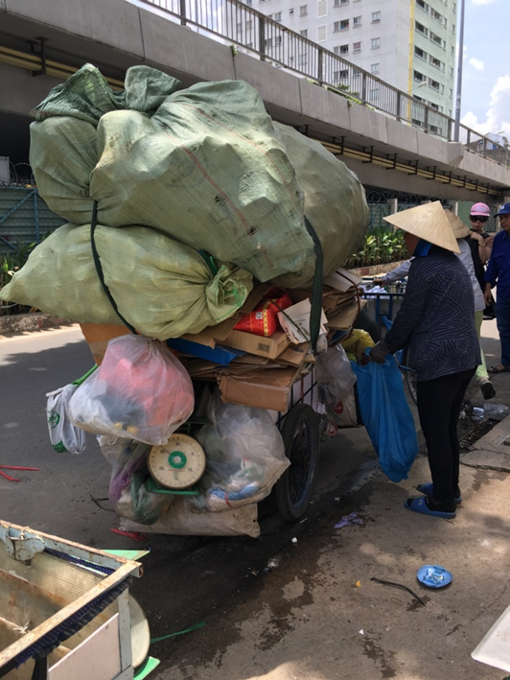
Develop Public and Private Sector Policy Playbook
Expected outcomes:
Analysis of current and possible policy and finance solutions for waste collection
“Playbook” of public and private sector actions needed for robust collection systems
Commitments by select companies and governments to work together

Slide 15
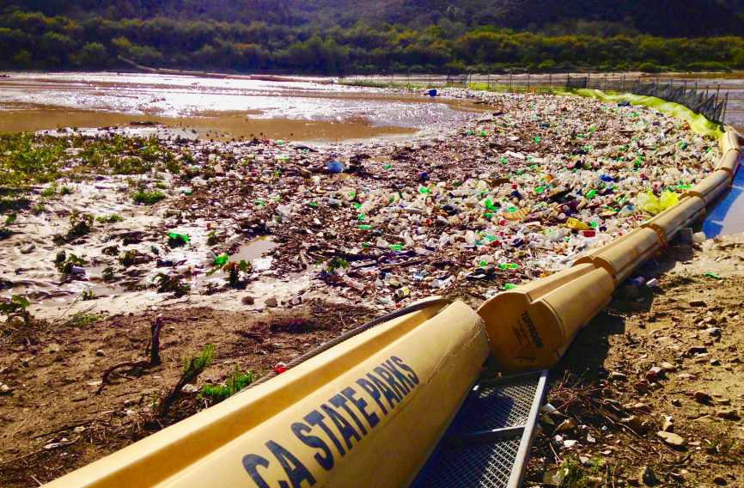
What Else Can We Do Together?

Slide 16
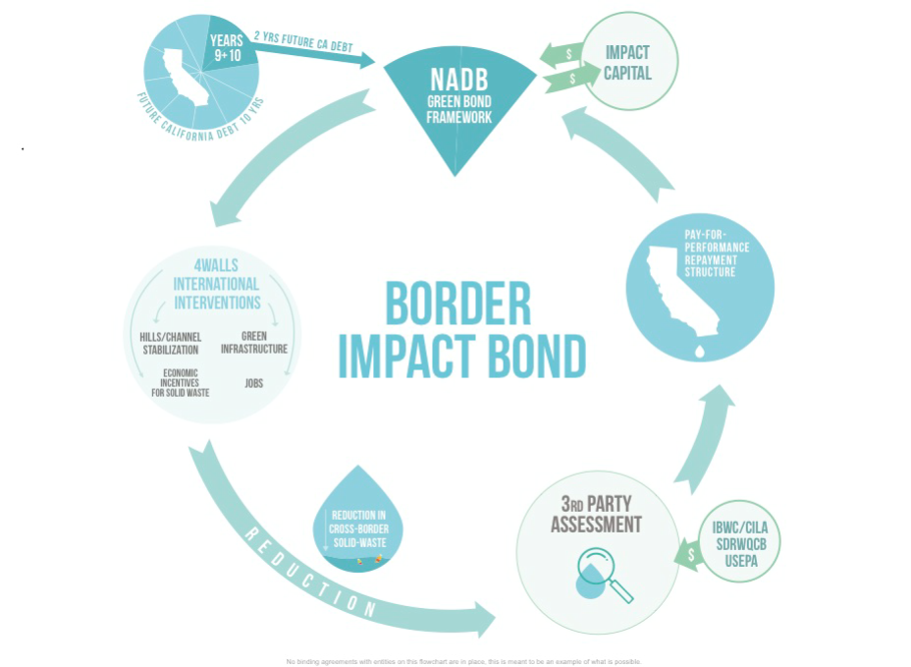

Slide 17
How you Can Help
For All: Support NADBank as the intermediary to issue the Border Impact Bond.
For United States: 1) Collaborate on the underlying science to provide baselines, monitoring ,and evaluation of upstream remediation. 2) Support California’s issuance of a pay-for-performance contract contingent upon success of upstream interventions.
For Mexico: Ensure upstream interventions that will generate jobs and improve the environment and living conditions of local residents can proceed.

Slide 18
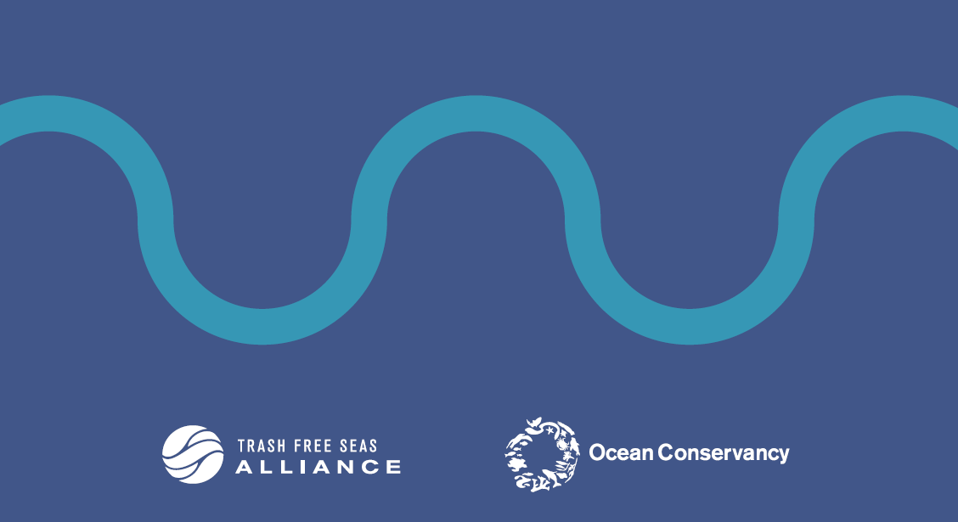
Thank you
Chever X, Voltmer
Plastics Initiatives Director
kbillsfreemyn@oceanconservancy.org

