Slide 1

Benefit & Cost Analyses in Support of an ECA Application for Mexico
Matt Haber
Eastern Research Group
CEC JPAC
Long Beach, California
December 12, 2016

Slide 2
Project Sponsor: Commission for Environmental Cooperation (CEC)
Through CEC, Canada, Mexico and US governments work together on joint priorities, including maritime emissions reductions efforts
Mexico actively pursuing accession to MARP0L Annex VI & submittal of ECA Designation Proposal to IMO
Canada, US sharing experiences in implementing North American ECA

Slide 3
Project Overview
Project designed to support Mexico’s effort to establish ECA
  similar to those in Canada and the US
Objective:
  Provide common approach to controlling emissions from ships across North America
ERG coordinated analysis & developed draft IMO application for ECA in Mexico
Collaborators:
  Molina Center for Energy & the Environment (Air Quality & Health Benefits Analysis)
  EnSys Energy, Inc. (Fuel Cost Analysis)
  Chester J. France, Consultant/Former EPA Official (Draft IMO Proposal)
Notes:
2) what we're doing - scope, schedule, end product
Current focus:
Task 1 – literature review, initial recommendations = Task 1 report
Task 2 – Initiating expert consultation process – we need your help (more on that in a minute…)

Slide 4
Project Tasks
Update Mexican Port Emissions Inventory
Develop “Open Source” Marine Emission Inventory Method
Air Quality & Health Benefits Analysis (MCE
Fuel Impact/Cost Analysis
Develop draft IMO Proposal
Notes:
2) what we're doing - scope, schedule, end product
Current focus:
Task 1 – literature review, initial recommendations = Task 1 report
Task 2 – Initiating expert consultation process – we need your help (more on that in a minute…)

Slide 5
Establishing an ECA
Under MARPOL Annex VI, applications to establish an ECA must address eight criteria, including:
  Demonstrating environmental impact of ships
  Assessing costs of implementing ECA
Comparison of program costs vs. health benefit not stated explicitly in criteria, but useful
  Can require detailed analyses
  IMO does not require level of detail used in Mexico
  Necessary detail determined by each country’s need for getting approval domestically
Notes:
2) what we're doing - scope, schedule, end product
Current focus:
Task 1 – literature review, initial recommendations = Task 1 report
Task 2 – Initiating expert consultation process – we need your help (more on that in a minute…)

Slide 6
ECA Designation Criteria
Summarized ECA Designation Criteria (MARPOL Annex VI, Appendix III):
Delineation of proposed area of application
Types of emissions proposed for control
Description of the human populations and environmental areas at risk from ship emissions
Assessment that emissions from ships contribute to ambient concentrations of air pollution or adverse environmental impacts
Meteorological or other conditions in the proposed area that contribute to these impacts
Description of ship traffic in the proposed ECA
Description of the control measures taken by the proposing party addressing land-based sources
Relative costs of reducing emissions from ships vs. land-based controls, and the economic impacts on shipping engaged in international trade
Notes:
2) what we're doing - scope, schedule, end product
Current focus:
Task 1 – literature review, initial recommendations = Task 1 report
Task 2 – Initiating expert consultation process – we need your help (more on that in a minute…)

Slide 7
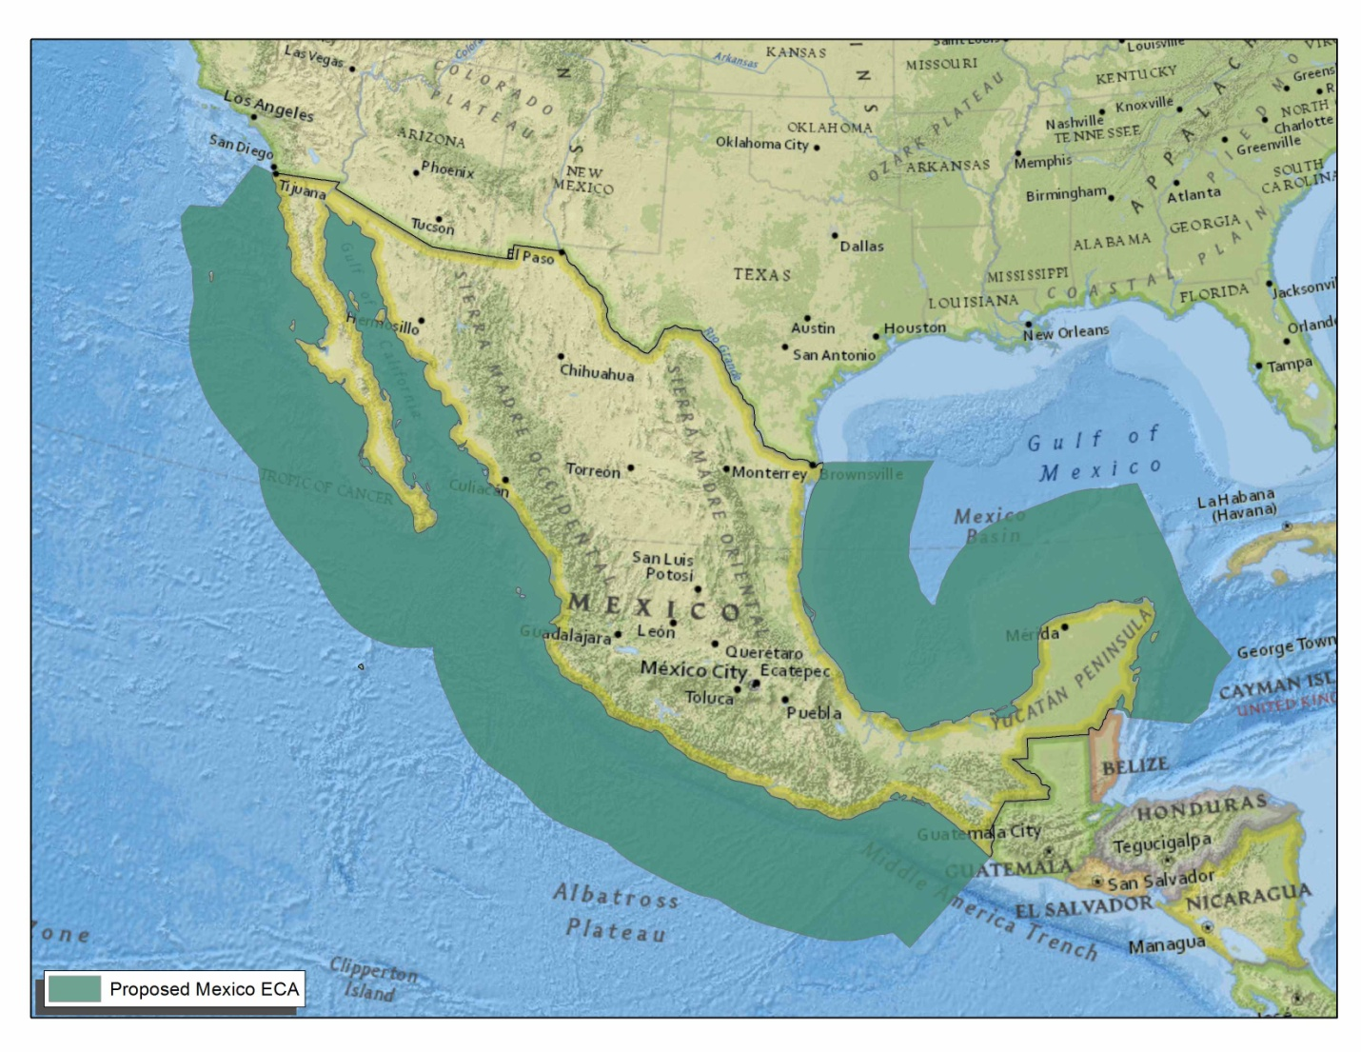
Proposed Mexico ECA
200 Nautical Miles
Notes:
2) what we're doing - scope, schedule, end product
Current focus:
Task 1 – literature review, initial recommendations = Task 1 report
Task 2 – Initiating expert consultation process – we need your help (more on that in a minute…)

Slide 8
Summary of Results
Significant Health Benefits
  3.3 million to 4.4 million fewer health incidences annually
    Includes excess mortality, hospital visits, lost school/work days
Nominal Cost
  Most costs borne by international vessels
    75% of emissions (→75+% of costs)
Monetized Health Benefits >>Cost of Fuel

Slide 9
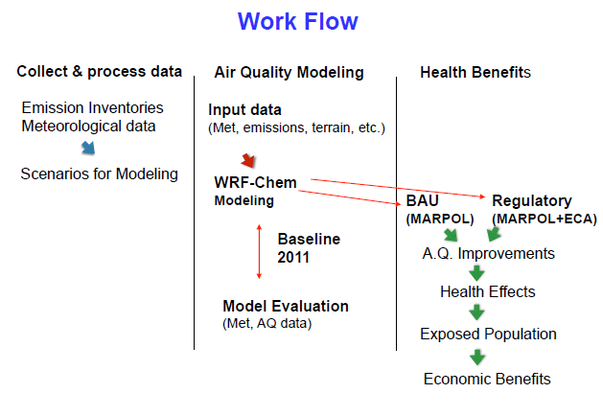
Air Quality & Health Benefit Analysis
Source: Molina Center for Energy & The Environment
Level of detail for Mexico analysis based on North American ECA
WRF-Chem is a photochemical air quality model, source of ambient Ozone and Particulate Matter estimates
BAU = Business As Usual (baseline case without proposed ECA)

Slide 10
Emissions Inventory
EERA estimated emissions & fuel consumption of oceangoing vessels within Mexican ECA, using AIS
  Of note: majority of emissions in Mexico ECA from ships not docking in Mexico (e.g. Panama Canal traffic)
ERG updated Mexican port emission inventories
  New cargo handling data provided by Mexican government
  Updated dockside fuel usage assumptions
  Updated vessel emissions factors
  Emission inventory developed for 35 Mexican Ports (2011 & 2030)
Notes:
2) what we're doing - scope, schedule, end product
Current focus:
Task 1 – literature review, initial recommendations = Task 1 report
Task 2 – Initiating expert consultation process – we need your help (more on that in a minute…)

Slide 11
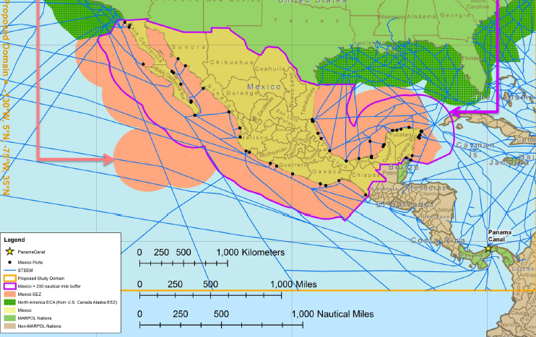
Mexico Ports and Shipping Lanes Source: EERA for U.S. EPA
Notes:
2) what we're doing - scope, schedule, end product
Current focus:
Task 1 – literature review, initial recommendations = Task 1 report
Task 2 – Initiating expert consultation process – we need your help (more on that in a minute…)

Slide 12
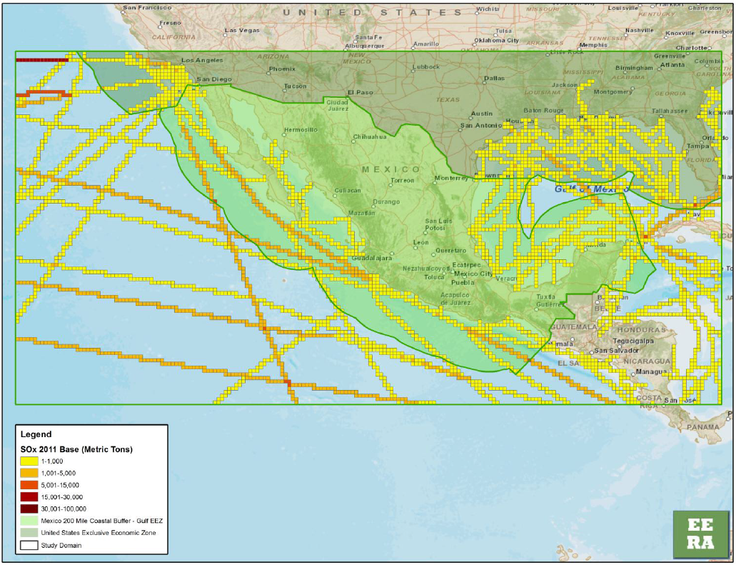
Emission Inventory Example:
Underway Vessel SO_{x} Emissions (2011) source: EERA for U.S. EPA
Notes:
2) what we're doing - scope, schedule, end product
Current focus:
Task 1 – literature review, initial recommendations = Task 1 report
Task 2 – Initiating expert consultation process – we need your help (more on that in a minute…)

Slide 13
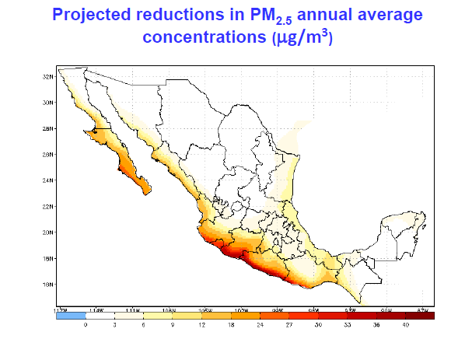
Air Quality Modeling:
Projected Reduction in PM _{2.5} (2030)
source: Molina Center for Energy & The Environment
Significant PM_{2.5} reductions in coastal areas and inland

Slide 14
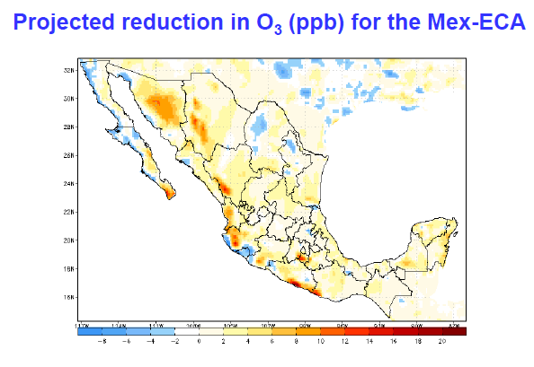
Air Quality Analysis:
Projected Reduction in Ozone (2030)
source: Molina Center for Energy & The Environment
Mix of O₃ results, but reductions in more populated areas

Slide 15
Air Quality Analysis:
Projected Reduction in SO₂ Deposition
source: Molina Center for Energy & The Environment
Reduction in SO₂ on heavy shipping lanes
Notes:
2) what we're doing - scope, schedule, end product
Current focus:
Task 1 – literature review, initial recommendations = Task 1 report
Task 2 – Initiating expert consultation process – we need your help (more on that in a minute…)

Slide 16
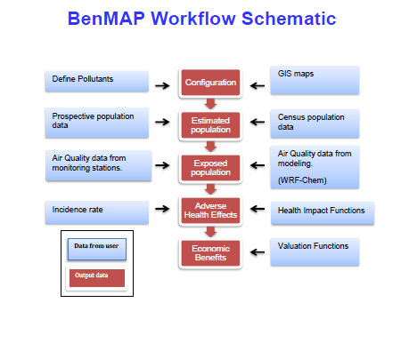
Health Benefits Analysis
source: Molina Center for Energy & The Environment

Slide 17
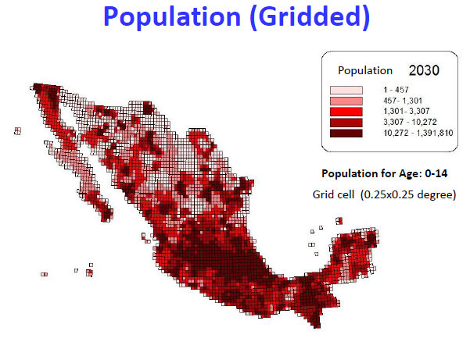
Health Benefit Analysis:
Exposure Assessment
source: Molina Center for Energy & The Environment

Slide 18
Health Benefits--PM

Slide 19
Monetized Health Benefit Results
source: Molina Center for Energy & The Environment
Health Endpoint | Age Range | Exposed Population (Million) |  | Economic Benefit (Billion US $)
Hospital Admissions – Cardiovascular | 18-64 | 85 |  | 0.054 (0.032-0.074)
Hospital Admissions – Respiratory | 65-99 | 14 |  | 0.002 (0.001-0.003)
Hospital Admissions – Asthma | 27-99 | 123 |  | 11.8 (5.7-18.0)
Chronic Bronchitis | 0-64 | 80 |  | 11.2 (5.4-17.0)
Mortality - All (Pope et al.) | 30-99 | 73 |  | 17.4 (6.9-28.0)
Mortality – Child Respiratory | 0-1 | 4 |  | 0.37 (-0.31 – 1.0)
Mortality – Sudden Infant Death Syndrome | 0-1 | 4 |  | 0.011 (0.005-0.017)
Restricted Activity Days | 18-64 | 85 |  | 0.002 (0.001 – 0.003)
Lost Work Days | 18-64 | 85 |  | 0.054 (0.047 – 0.060)
Total w/ Pope et. al mortality estimates |  |  |  | 41 (18 –64)
Mortality - All (Laden et al.) | 25-99 |  | 84 | 43.0 (23.0-61.0)
Total w/ Laden et. al mortality estimates |  |  |  | 67 (34-97)
Estimated Benefits: US $41-67 Billion (2012)
Notes:
2) what we're doing - scope, schedule, end product
Current focus:
Task 1 – literature review, initial recommendations = Task 1 report
Task 2 – Initiating expert consultation process – we need your help (more on that in a minute…)

Slide 20
Cost Analysis
Two elements: 1) fuel and 2) vessel costs
Fuel cost analysis performed by EnSys Energy, Inc.
  World Oil Refining Logistics & Demand (WORLD) model updated to allow Mexico focus
  Assessed fuel cost impact globally and within Mexico to reduce Mexico ECA fuel from 0.5% to 0.1% Sulfur
  Global fuel cost estimate: US$ 4.03 Billion
Vessel cost based on North American ECA study
  Operation: Urea consumption
  Vessel upgrades: fuel tank modifications, SCR
  Vessel cost estimate: US$ 0.43 Billion
Total cost estimate: ~ US$ 4.5 Billion (2012$)
Notes:
2) what we're doing - scope, schedule, end product
Current focus:
Task 1 – literature review, initial recommendations = Task 1 report
Task 2 – Initiating expert consultation process – we need your help (more on that in a minute…)

Slide 21
Benefit:Cost Comparison
Benefit:Cost Midpoint ~ 12:1
Comparison to land-based mobile source emission control programs in U.S.:
Mexico ECA falls in range of U.S. programs
U.S. Program | Benefit:Cost Midpoint
US “Tier 3” Light Vehicle & Fuel Standards | ~ 9 : 1
US Heavy-Duty 2007/2010 Standards | ~ 17 : 1
US Nonroad Tier 4 Standards | ~ 40 : 1
Notes:
2) what we're doing - scope, schedule, end product
Current focus:
Task 1 – literature review, initial recommendations = Task 1 report
Task 2 – Initiating expert consultation process – we need your help (more on that in a minute…)

Slide 22
Conclusions
To address ECA criteria for Mexico
  Analyses were performed (modeled after the US NA ECA submittal)
    Emissions inventory
    Air quality modeling
    Exposure and health benefits modeling
    Fuel & vessel costs estimation
    Comparison of Benefit:Cost to land-based programs
      Analysis shows favorable Benefit:Cost for Mexico
Notes:
2) what we're doing - scope, schedule, end product
Current focus:
Task 1 – literature review, initial recommendations = Task 1 report
Task 2 – Initiating expert consultation process – we need your help (more on that in a minute…)

