Slide 1
Energy Management at 3M Canada
Andrew Hejnar, P.Eng Engergy Manager, 3M Canada

Slide 2
Our Vision
3M Technology Advancing Every Company
3M Products Enhancing Every Home
3M Innovation Improving Every Life
Notes:
At 3M, we have one Vision.
It is ambitious. Aspirational. Challenging. And attainable.
Not just because of what we do, but because of how we do it.
We are a company rooted in scientific exploration and discovery … and the belief that every problem has a solution.
And it sums up in our ambition to improve every life.

Slide 3
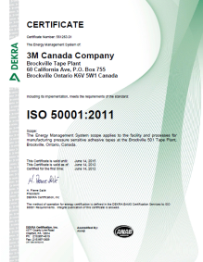
An Introduction to 3M
3M Sustainability
Energy Management Initiatives
Results
Insight
Energy Management at 3M OVERVIEW

Slide 4
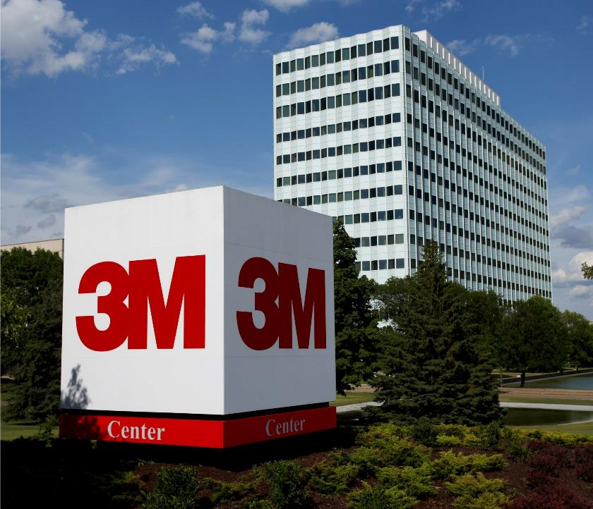
Since 1902
Subsidiaries in 71 countries
Sales in nearly 200 countries
~89,000 employees
International sales $18B
200+ factories
Sales: $30.3B
Free Cash Flow: $5B
R&D investment: $1.8B
55,000+ products
+100,000 patents
2015 figures
4

Slide 5
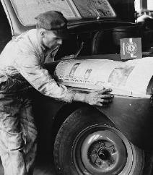
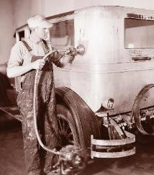
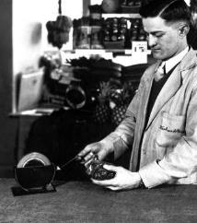
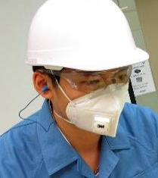
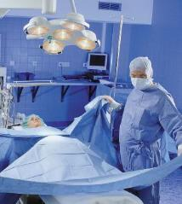
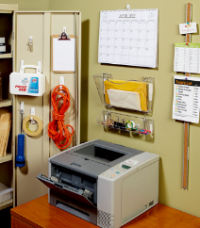
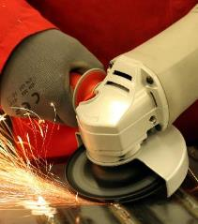
Science improving
lives for more than
a century
Wetordry™ Sandpaper
Scotch® Masking Tape
Scotch® Cello Tape
Scotchlite™ Reflective Signage
3M™ Flat Fold Disposable Respirator with Valve
Scotch-Brite™ Sponge
Micropore™ Medical Tape
Command™ Adhesive Strips
Post-it® Notes
3M™ Aluminum Conductor Composite Reinforced (ACCR)
Cubitron™ Abrasives
3M™ 360 Encompass™ System
Scotch® Magnetic Tape
Notes:
In 1902 five individuals founded 3M … originally as an ambitious mining venture.
Today 3M is: The adhesive holding your plane together … The respirator helping you breathe easier … The sterile bandage used by your surgeon … The reflective traffic sign guiding you home at night … And yes, the Post-it® Note keeping you organized.

Slide 6
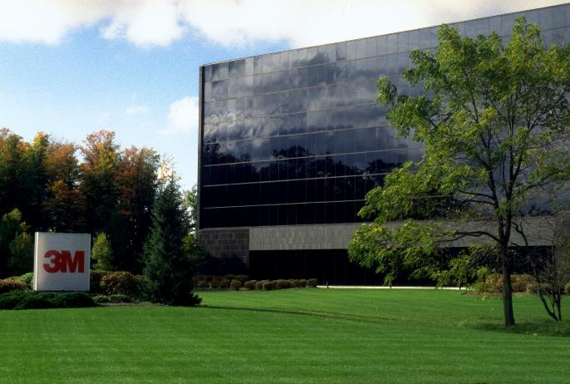
3M Canada
First 3M subsidiary (1951)
Employs 1,800 people
Seven manufacturing facilities
Abrasives
Tapes
Healthcare
Scotch-Brite
First subsidiary to have full time energy manager

Slide 7
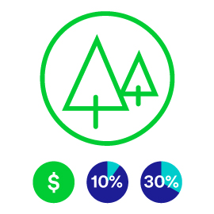
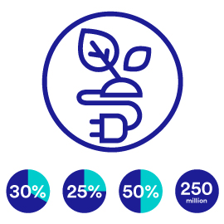
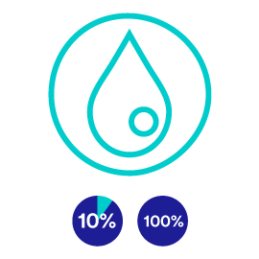
2025 Goals
Raw Materials
Energy & Climate
Water
Health & Safety
Education & Development
Notes:
We are proud of our performance against our Social Responsibility and Economic Success goals as well, and in our 2025 Sustainability Goals, we are significantly expanding our commitments in these important areas.
Raw Materials: Invest to develop more sustainable materials and products to help our customers reach their environmental goals. • Reduce manufacturing waste by an additional 10%, indexed to sales. • Drive supply chain Sustainability through targeted raw • Achieve “zero landfill” status at more than 30% of manufacturing sites. material traceability and supplier performance assurance
Energy & Climate: Improve energy efficiency indexed to net sales by 30% • Increase renewable energy to 25% of total electricity use • Ensure GHG emissions at least 50% below our 2002 baseline, while growing our business • Help our customers reduce their GHGs by 250 million tons of CO2 equivalent emissions through use of 3M products
Water: Reduce global water use by an additional 10%, indexed to sales. • Engage 100% of water-stressed/scarce communities where 3M manufactures on community-wide approaches to water management.
Health & Safety: Provide training to 5 million people globally on worker and patient safety
Education & Development: Invest cash and products for education, community and environmental programs. • 100% participation in employee development programs to advance individual and organizational capabilities. • Double the pipeline of diverse talent in management to build a diverse workforce.

Slide 8
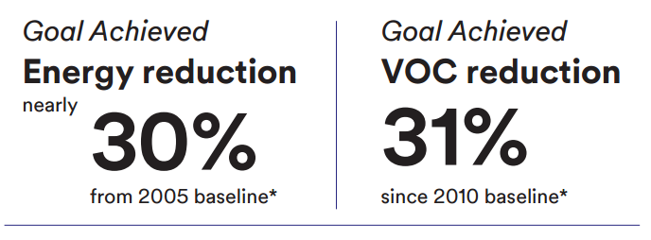
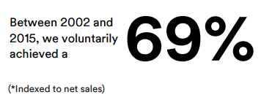
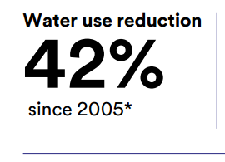
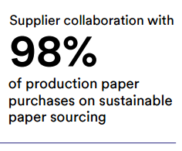
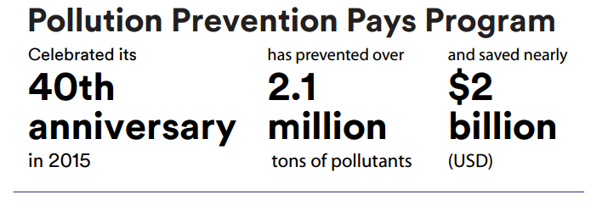
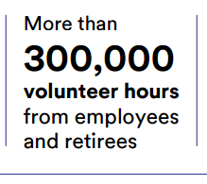
Our Sustainability Progress
Delivering on our 2015 Sustainability Goals 2015 Results
Notes:
Setting goals to drive Sustainability progress is nothing new at 3M. We have been setting global environmental goals since 1990. A strong part of our company history, these goals have helped dramatically reduce our own environmental footprint and established us as a leader in environmental stewardship. Our 2015 Sustainability Goals program continued our drive to reduce our own environmental impacts, but also expanded our targets to include social responsibility efforts and economic success factors.

Slide 9
What Motivates Energy Management at 3M?
Mitigate Increasing Energy Costs
Employee Satisfaction
Reinforce Our Reputation
Global Sustainability Commitments
Enhance Competitive
Position
SUSTAINABILITY

Slide 10
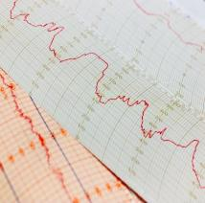
3 Pillars of Successful Energy Management (EnMS)
Vehicle to achieve this is SEP with ISO 50001
METERING & TARGETING
TECHNOLOGY PROJECTS
PEOPLE

Slide 11
Voluntary international standard framework to manage energy
Based on “Plan–Do–Check–Act” continuous improvement cycle
Leads to improved energy performance
Integrates energy efficiency into management processes
Many core elements in common with ISO9001 (quality) and ISO14001 (environmental) ISO standards

Slide 12
SEP – Superior Energy Performance
Notes:
US DOE and industry partnership program for energy performance
Fully incorporates ISO 50001 but adds more requirements per ANSI/MSE-50021 standard
Prescribes specific silver-gold-platinum energy reduction
Assesses performance with International M&V Protocol
Global SEP supported by 13 countries, including Canada, USA and EU

Slide 13
First Pillar of EnMS - Metering and Targeting
What you can’t measure, you can’t control - Make energy visible
Metering
Sub-metering
Energy Map: where energy is used and how much it costs
Targeting
Establish energy baselines
Establish energy targets, normalized for variables
Provide real-time energy information for operating personnel
Provide energy consumption reporting for management (tracking and budgeting)

Slide 14
Second Pillar of EnMS - Technology
Combined Heat and Power (CHP)
Reduce annual energy spend
Reduce purchase of electricity
LED Lights - Outdoor/Indoor
Mature technology now
Compressed Air Optimization
The most expensive energy: 7HP of electricity used to produce 1HP compressed air
HVAC
Process Integration
Replace with equipment not requiring compressed air, electric blowers mixers etc.
Reduce air leaks most plants leak at 20-30%
Conditioning of air is very expensive - $3 per CFM per year
Air balance studies to reduce exhaust and makeup air
Re-commissioning of existing equipment
Evaporative Cooling
Reduce Cost of Goods Sold (COGS)
Significant energy consumption savings (60-90%)
Better illumination and light quality
Longer life – lower maintenance cost
Process integration analyzes energy use a whole, rather than considering each energy system independently
Heat recovery
Chilled Water
HVAC
Heaters
Motors

Slide 15
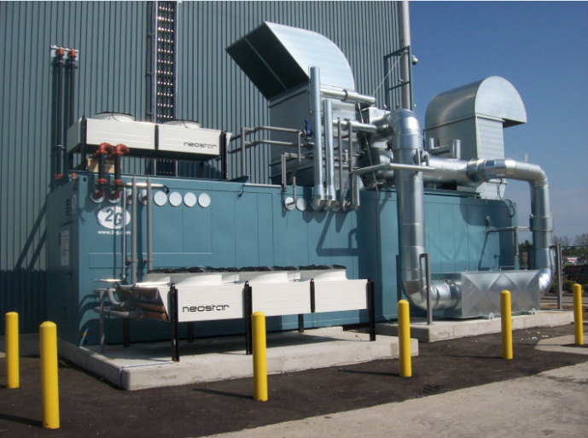
Where does CHP makes sense?
Stable and low natural gas prices
High electricity cost
Steady electrical base load
Steady heat sink for heat recovery
Government / local utilities support

Slide 16
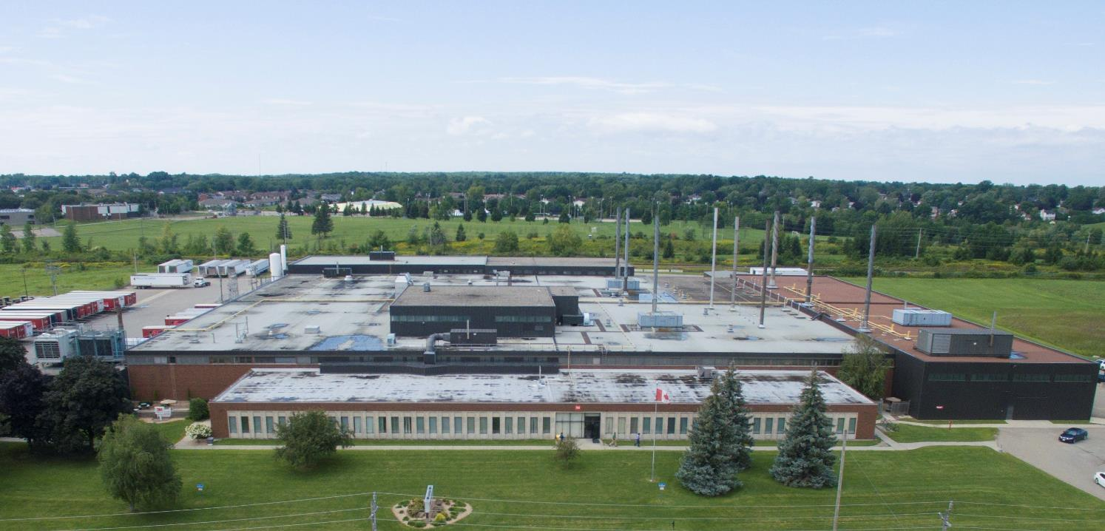
Notes:
Brockville Tape Plant
CHP Results
2 MW natural gas internal combustion (CHP)
Behind the meter - generate 80% of power, while still connected to the grid
Project received 40% funding from Ontario Power Authority (OPA)
IRR 28%, Payback 3.4 yrs
Benefits:
Reduces annual energy spend by 30%
Reduces plant COGS by 0.8%
Reduces purchase of electricity by 15,000 MWh per year
Relighting project
First stage in 2008 Fluorescent measure –
Metal Halide, High Pressure Sodium and T12 fluorescent relighted to T8 fluorescent fixtures production areas and offices
Energy saved = 770 MWh (or 60%)
Cost reduction = $100k
Payback 1.8 years with incentives
Second stage, Oct 2014, LED measure – Relighting T8 fluorescent to LED
Energy saved = 300 MWh (or 50%)
Cost reduction = $40k
Payback 1.9 years with incentives
Overall savings from stage one and two
Energy saved = 1.1 GWh (or 83%)
Cost reduction = $140k

Slide 17
Third Pillar of EnMS - People
Why?
They operate equipment that consumes energy
How?
Energy Conservation Awareness Campaigns
They know the equipment
Better employee retention and satisfaction
Increased trust in management
Energy Training
Employee Suggestion Program
Communication
Let them know they matter

Slide 18
Location | Certification
Canada | SEP/ISO 50001 – First Canadian Enterprise with six facilities certified (one SEP)
US | SEP/ISO 50001 – Enterprise with six facilities certified (all SEP)
Germany | ISO 50001 - six plants certified
Poland | ISO 50001 - two plant certified
Korea | ISO 50001 - one plant certified
France | ISO 50001 - one plant certified
3M Canada Brockville PSD Plant Pilot for The Commission for Environmental Cooperation (CEC) as part of Clean Energy Ministerial in collaboration with Natural Resources Canada (NRCan), Mexico’s National Commission for the Efficient Use of Energy (CONUEE) and the US Department of Energy (DOE)

Slide 19
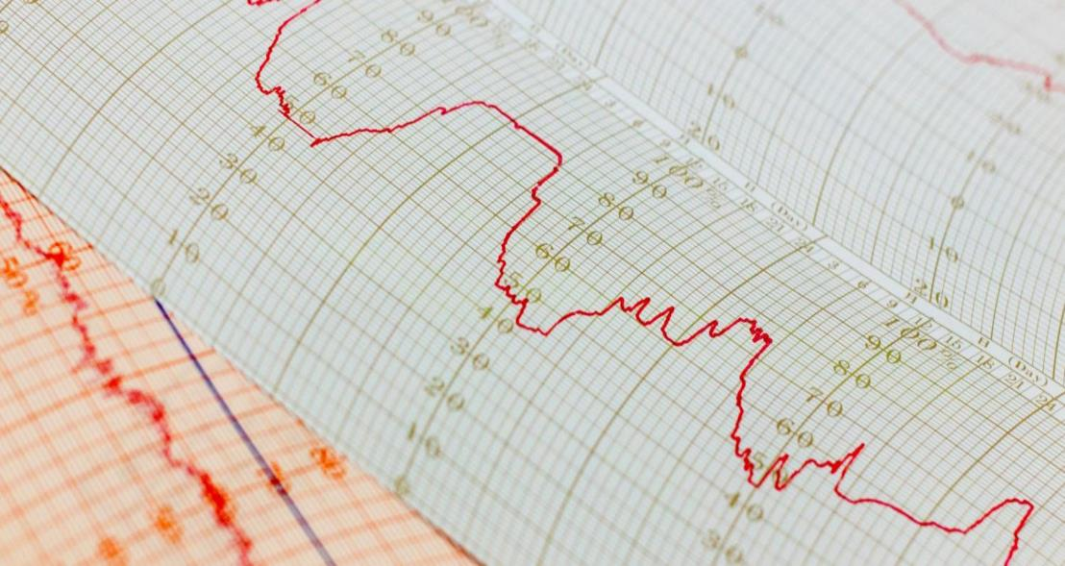
We are part of the solution
3M Canada has taken active measures on energy management and GHG reduction over many years
CO2e
Energy Intensity
Reduced 71.3 Metric Tones
22% Reduction in BTUs/lb
140
Energy Improvement Projects
Since 2008
Natural Gas
Electricity Consumption
Reduced 10 Million Cubic Meters
Reduced by 18 GWH
3 x Canadian Industry Program for Energy Conservation (CIPEC) Energy Awards
$ Savings
$11 M
2014 - in Corporate Stewardship
2016 - in Energy Management National Award
2016 - in Employee Awareness

Slide 20
3M London and two Perth plants completed Energy Star Challenge a year early
Challenge calls for 10% energy intensity improvement over 3 years from 2012 baseline
Both plants are second 3M recipients (over 20 participants)
London Plant achieved 30% Energy Performance Improvement
Perth Tape Plant achieved 15% Energy Performance Improvement
Perth ScotchBrite Plant achieved 11% Energy Performance Improvement

Slide 21
Energy Management System Benefits
Increased Awareness of Energy Performance
Improved Procurement & Engineering Practices
Improved O&M Practices
Increased Idea Generation Suggestion System
Improved Energy Performance = Lower Cost

Slide 22
Key Success Factors
Senior Management Commitment
Selection of Team Members
Expert Consultant Support
Government And Local Energy Suppliers Support
Legacy of Corporate Leadership In Sustainability
A Culture of Sustainability
METERING & TARGETING
TECHNOLOGY PROJECTS
PEOPLE

Slide 23
Thank you
3M.com/Sustainability
#Improvinglives
Notes:
3M.com/sustainability #improvinglives

