Slide 1
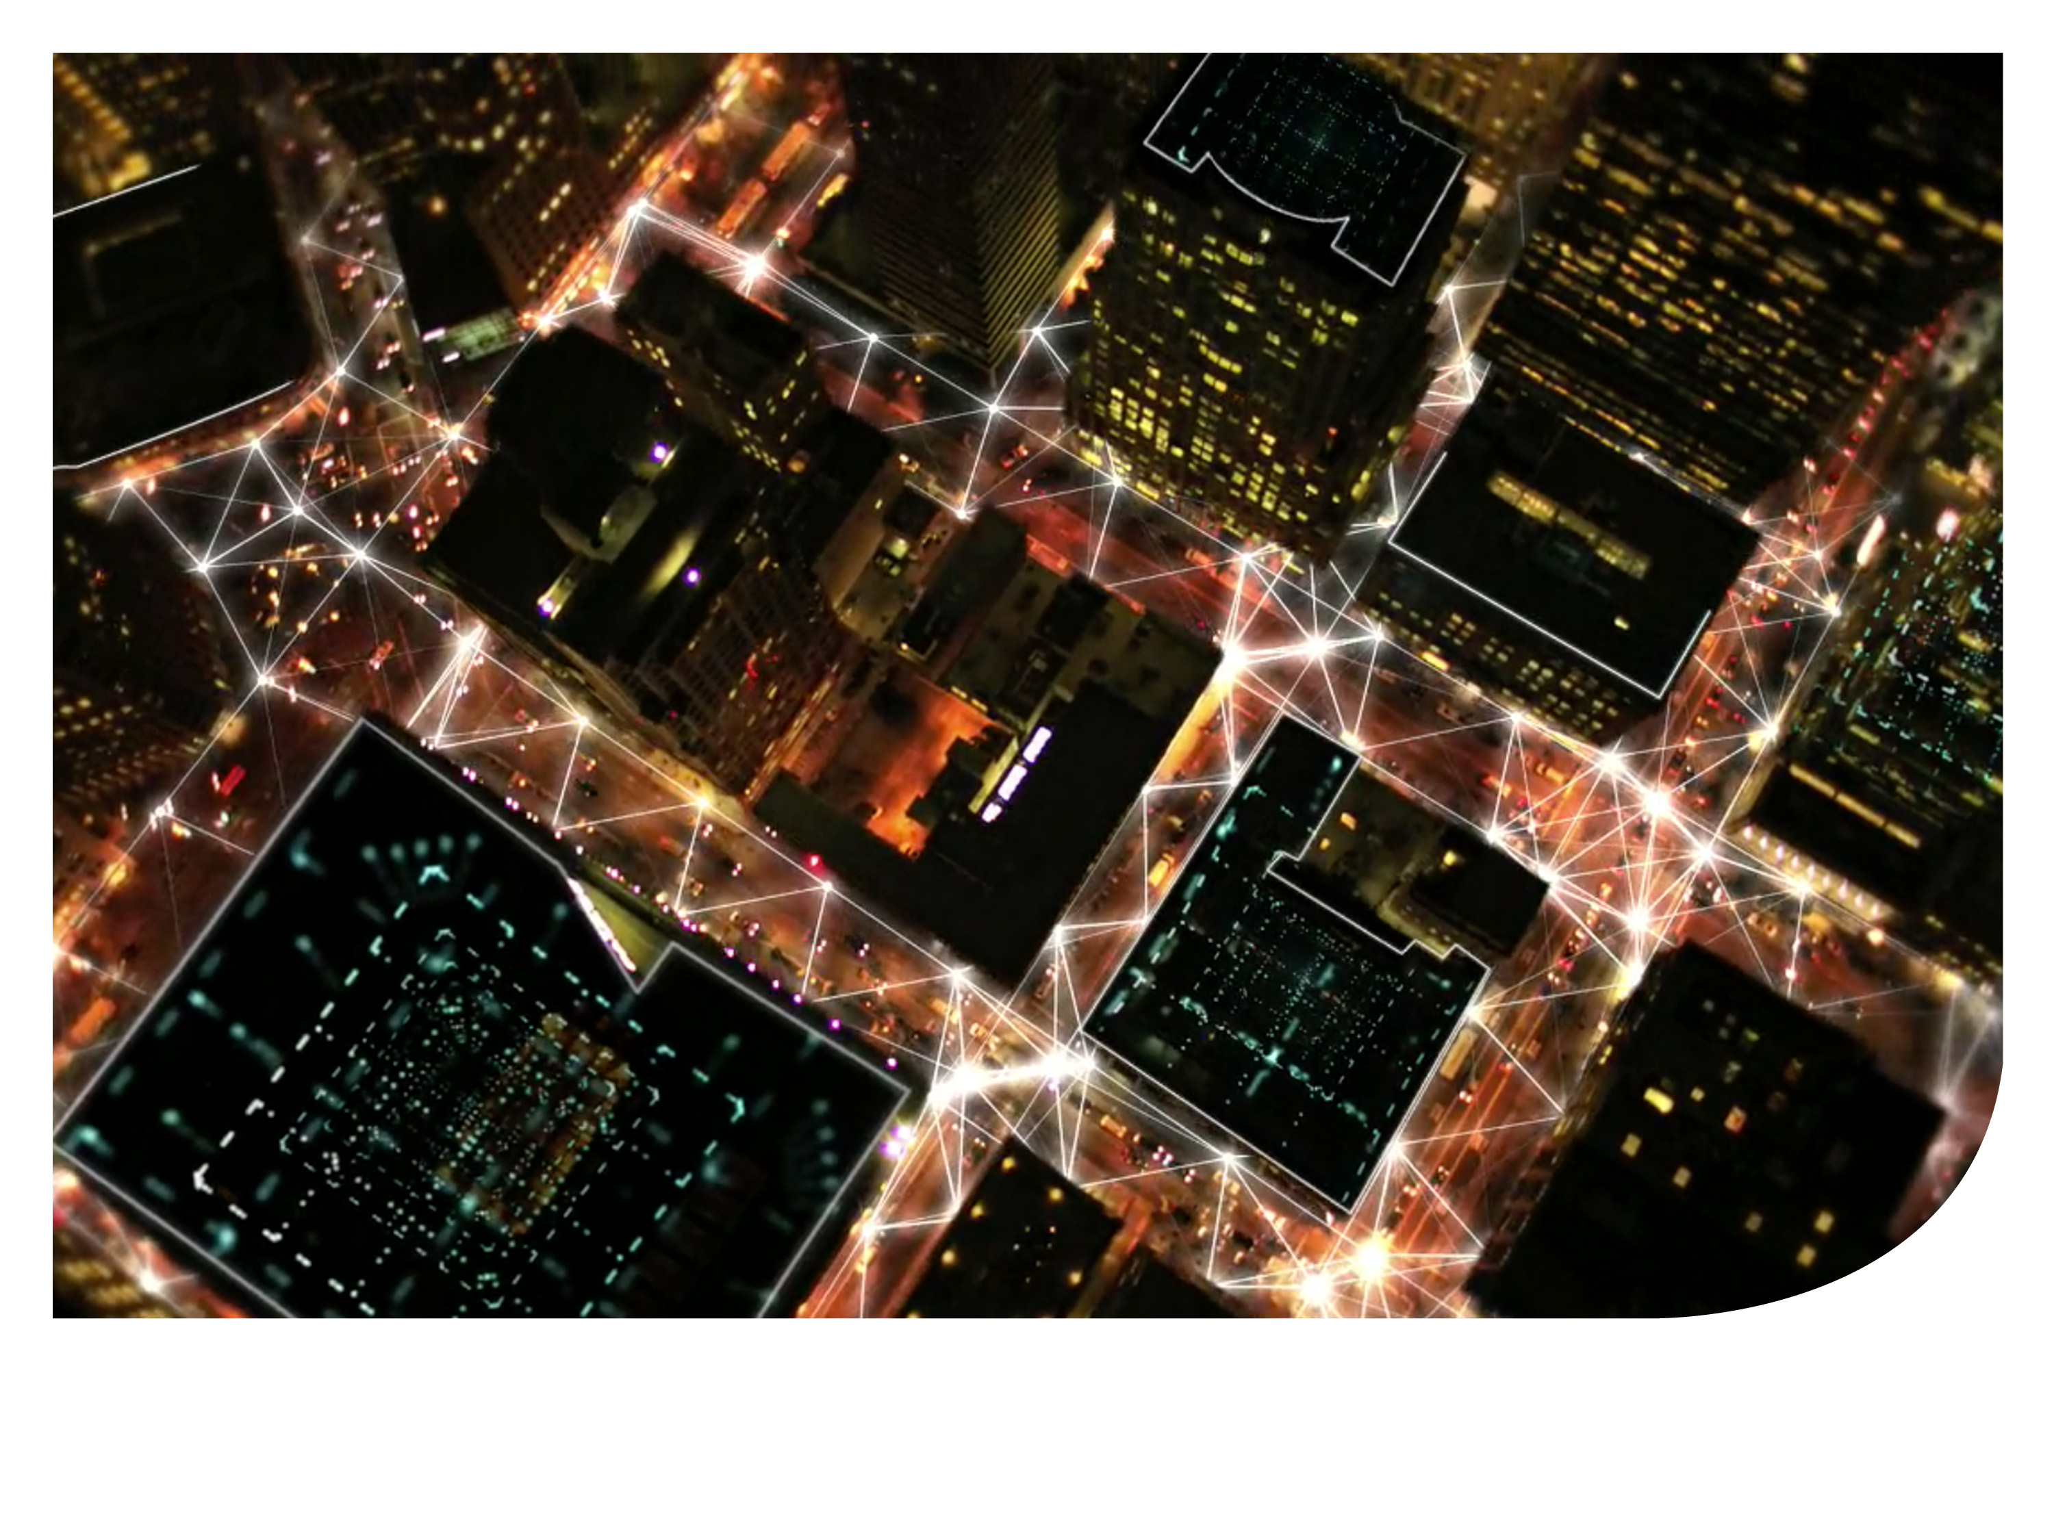

Empowering smart cities
with connected lighting
CEC November 7, 2016
Daryll Nazarene

Slide 2
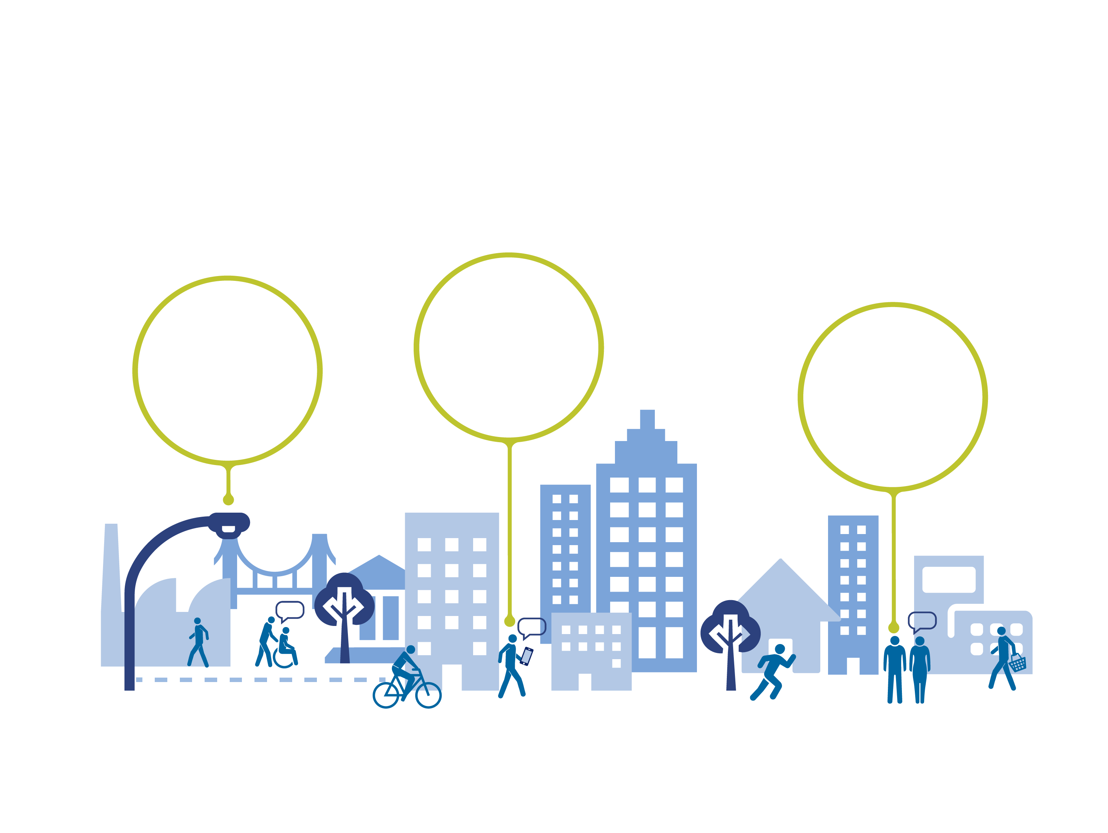
Cities and communities are on the rise
Many dimensions to urbanisation
Connected citizens:
97% have a mobile phone subscription
47% have access
to mobile data²
Cities:
use 75% of global primary energy today¹
Urban population: will grow from 50% to 70%
by 2050³
Residents looking for better services and City Officials need smart + sustainable solutions that can transform their ageing infrastructure
¹ UN Habitat
² World Bank and ITU, World Telecommunication/ICT Development Report and Database, 2015
³ United Nations – Department of Economic and Social Affairs, ‘World Urbanization Prospects’, 2014

Slide 3

Global cities are expected to do more with less
Facing financial pressure, global climate and technological challenges
City must define their smart city strategy and policy that fits their need, enhances operational performance and enables them to take better fact-based decision.

Slide 4
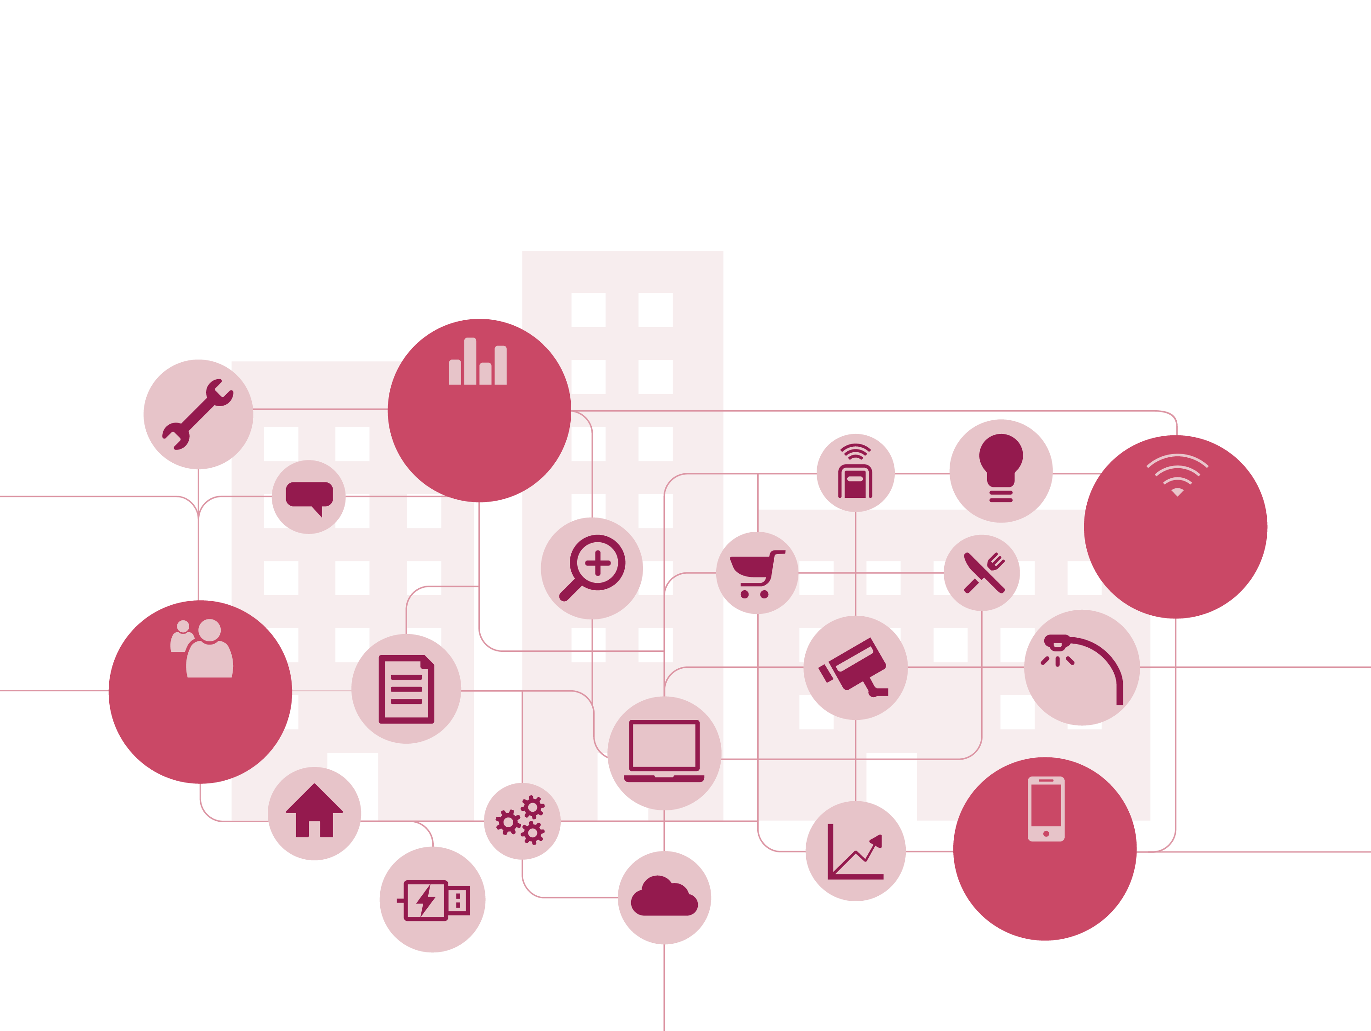
With rise in digital, by 2020 most system needs
To be connected, scalable and open
50+ trillion GB of data
25+ billion embedded, intelligent systems
4+ billion connected people
25+ million apps
Vision – Empowered cities with connected lighting
Source: Mario Morales, International Data Corpora-on (IDC). Forecast for 2020

Slide 5

Our smart city vision for next decade
Is built on three pillars
The right light
Connected operations
Evolving applications

Slide 6
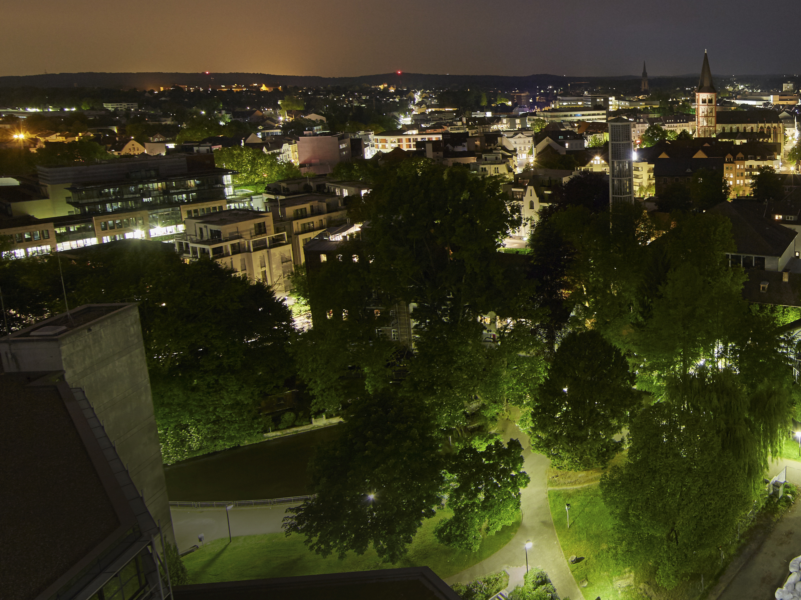
Lighting dimmed in industrial area
100% light output for footpaths through the
city park
Dynamic scheduling provides the right light
Siegburg, Germany

Slide 7

Connected operations
Deeper insight for end users & operators

Slide 8
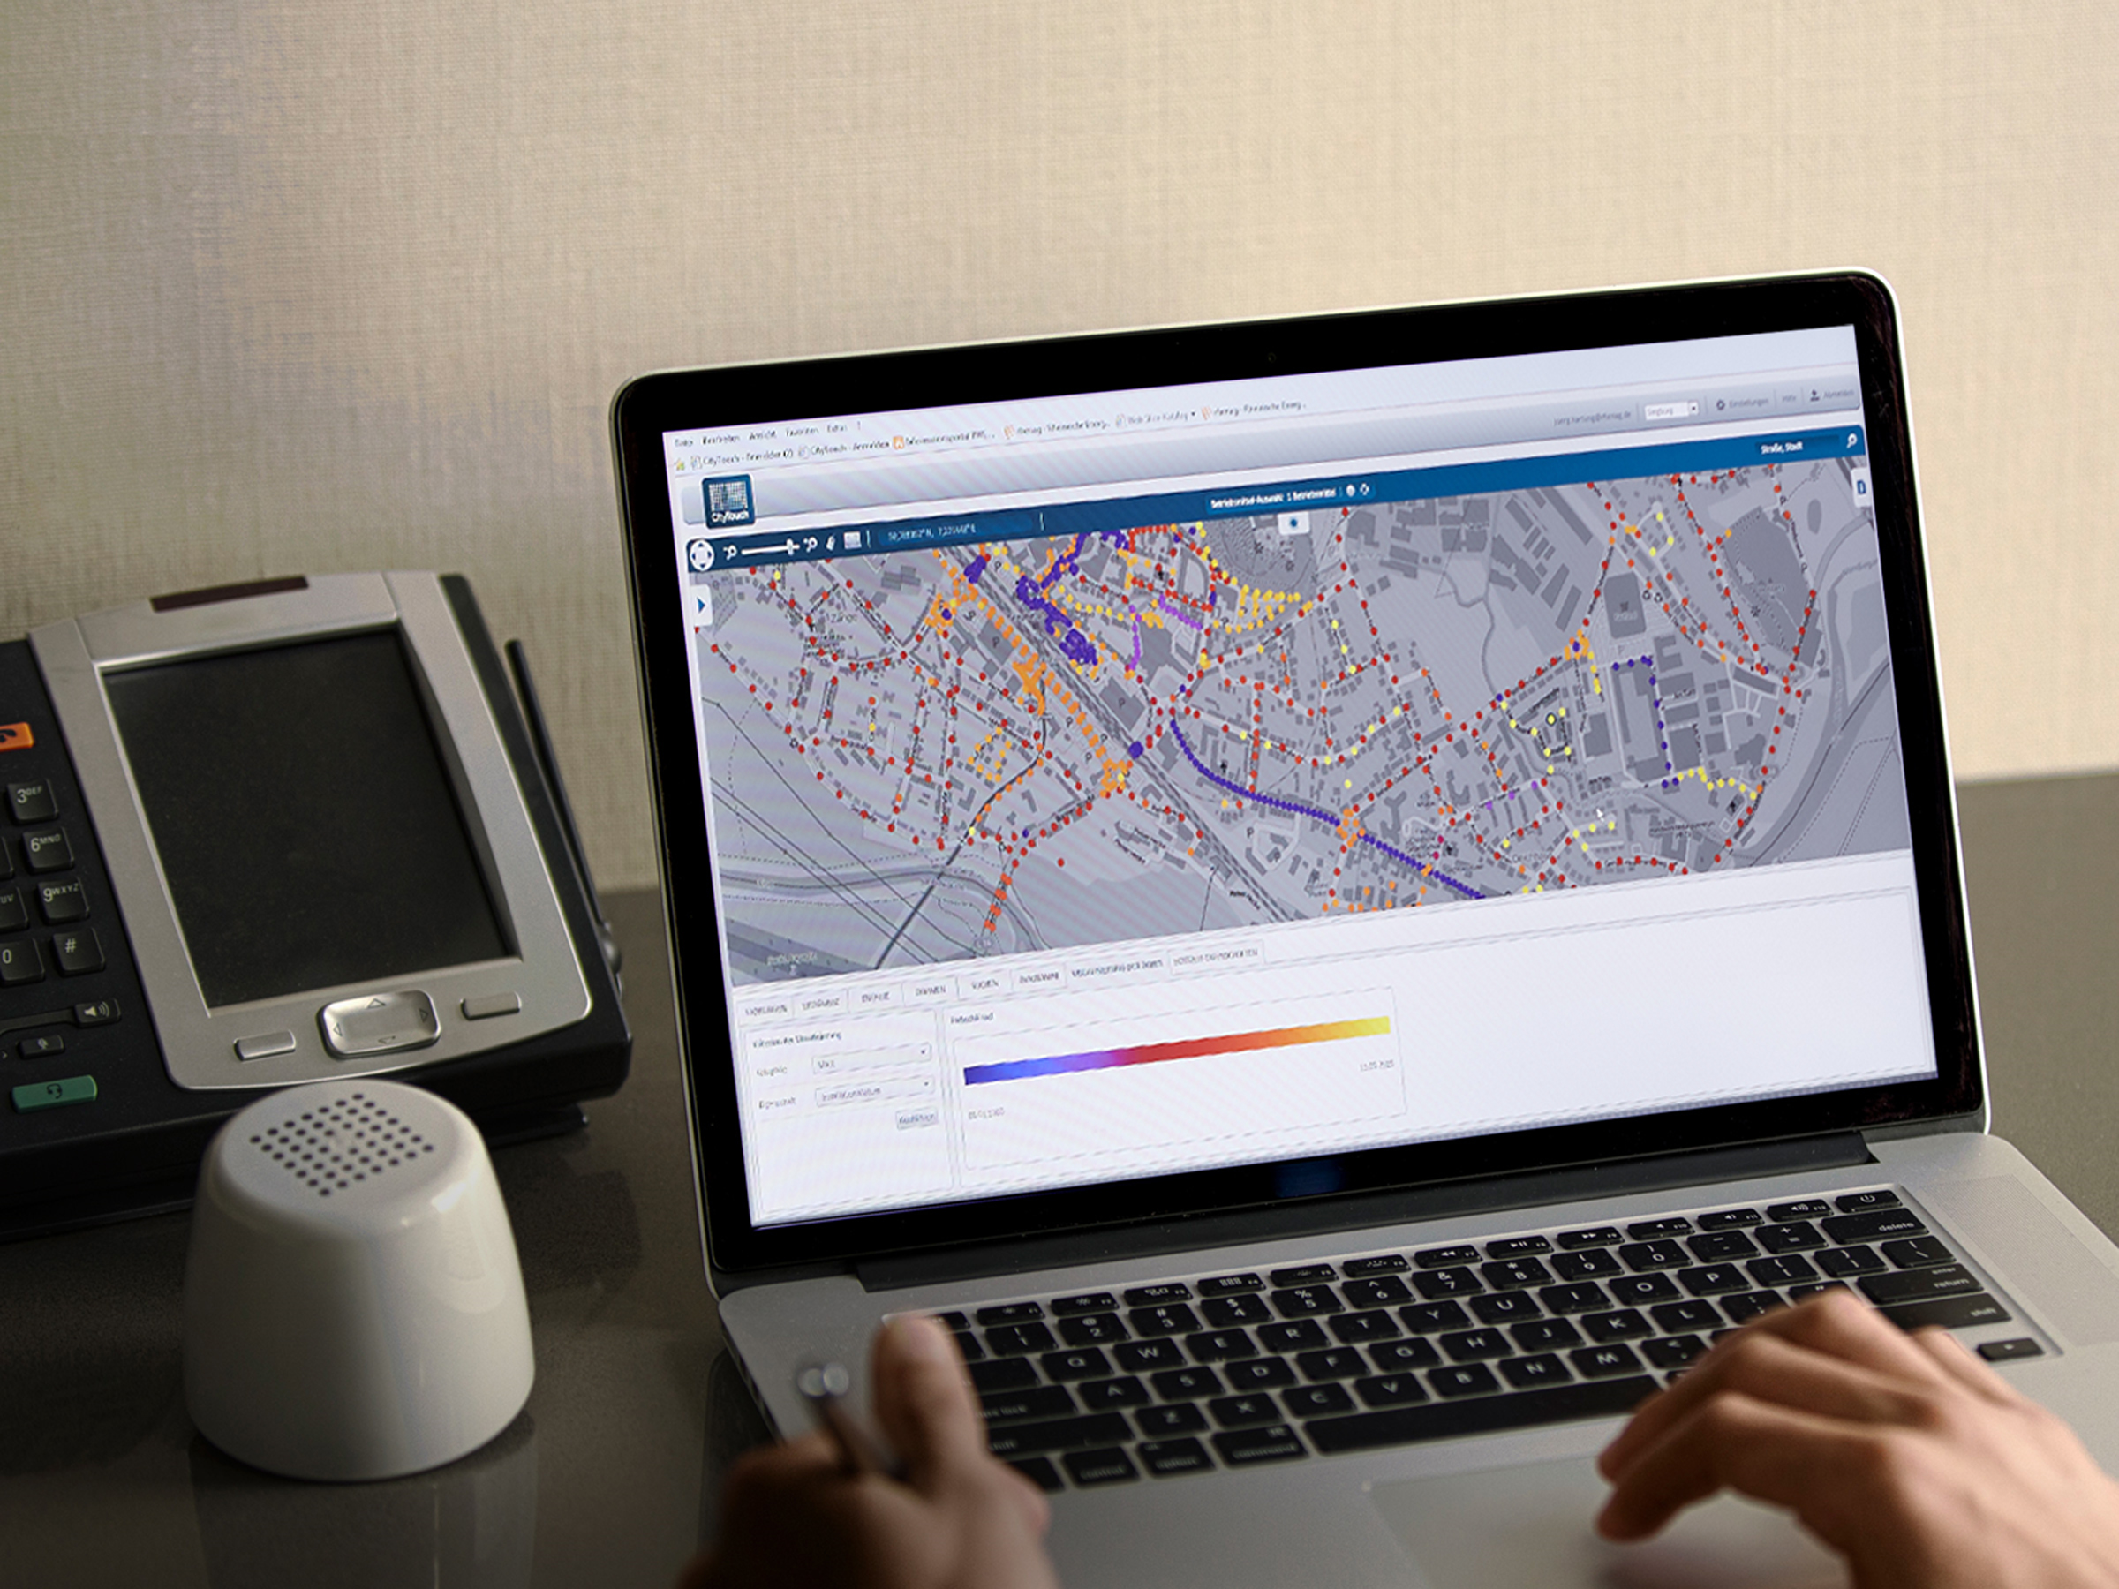
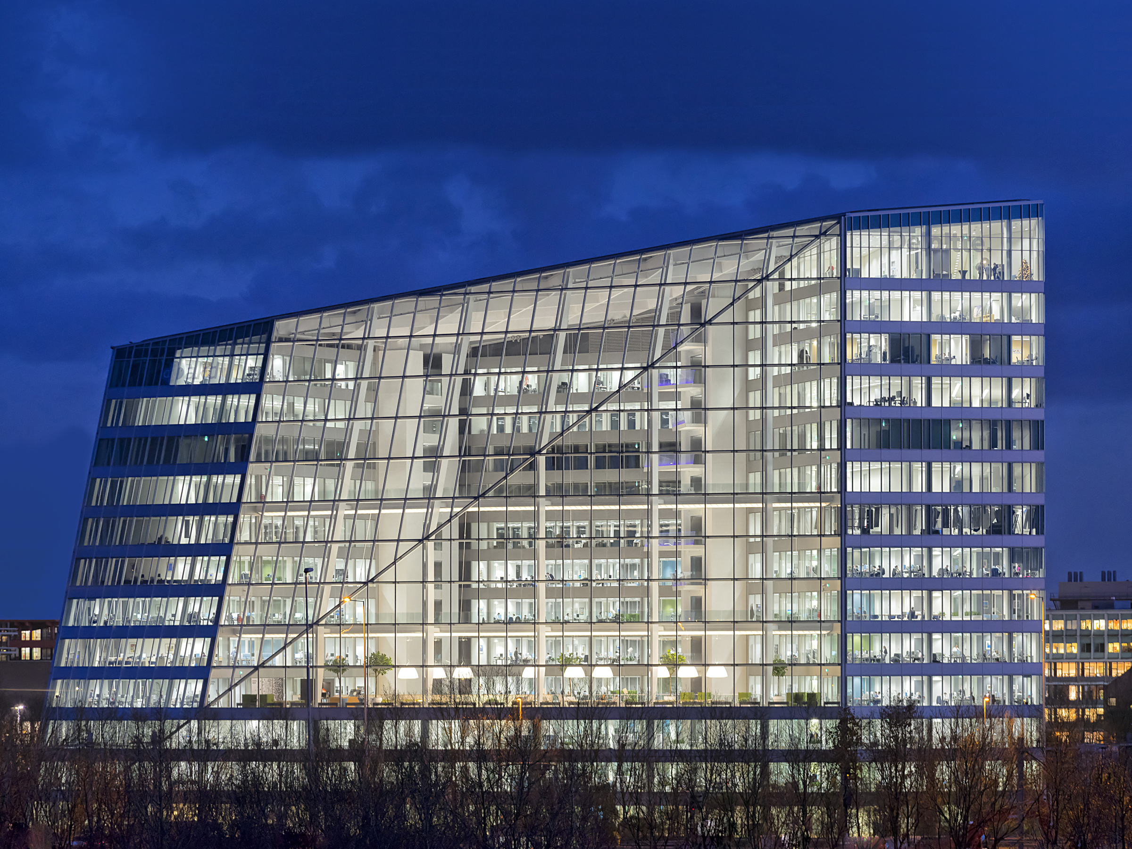
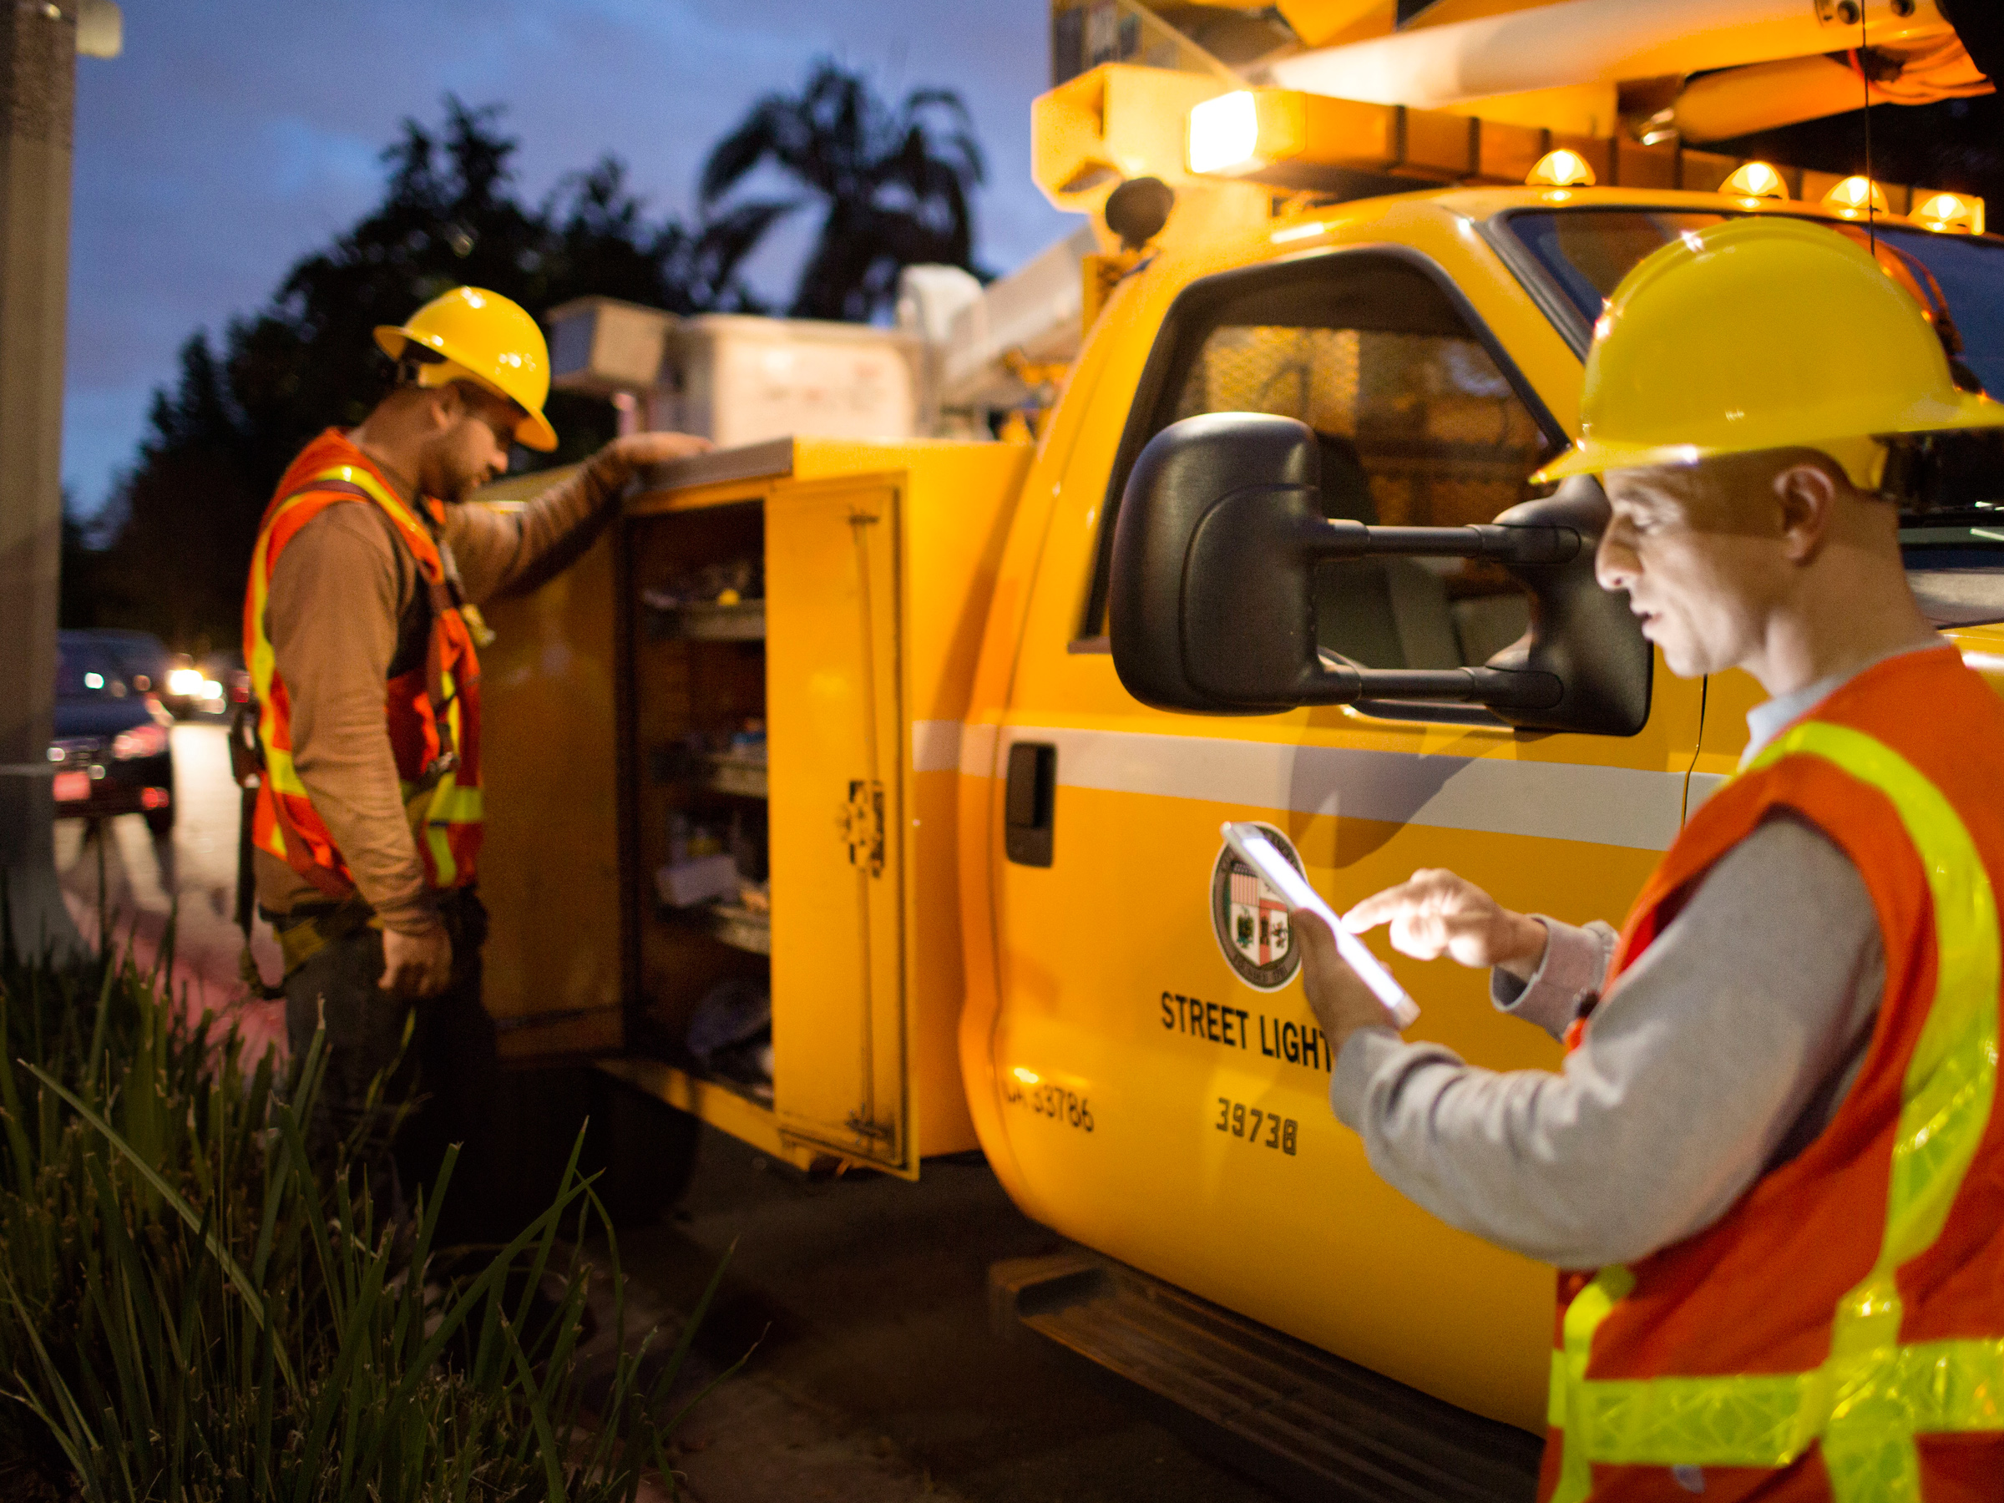
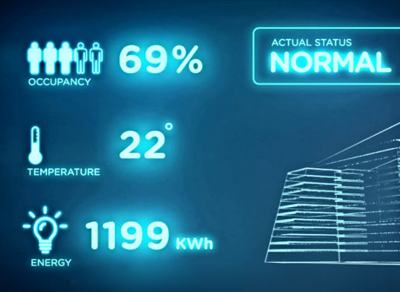
Operators control
light levels remotely
POE technology enables new forms of data analysis
for end users
Field technicians can access information anytime, anywhere
City of Los Angeles, USA

Slide 9

Return on investment
Within sight
Buenos Aires replaced 91,000 streetlights with LED technology that will cut the city’s energy use by more 50%. Payback for LED is <5 years and Smart controls is 7 years. The city is benefitting from its connected lighting system:
Lower maintenance costs:
New LED luminaires last
up to 5x longer than most HID lighting
Operational efficiencies:
Outage Response rates reduced from 19 to less than 10 days
Annual operating budget . educed by 60%
Effective energy usage:
Remote dimming / trimming of streetlights during heightened energy usage saving additional 25% energy savings, powering up more homes

Slide 10

Connected Lighting Systems for smart city applications

Slide 11

Public lighting is everywhere
But connectivity is not
~44
million street lights in North America¹
Lighting can account for
up to 40% of a city’s total energy consumption²
40%
On average, public lighting is more than 20 years old³
~2% of installed systems are connected, expected to reach 35% by 2025³
¹ Northeast Group, Global LED and Smart Street Lighting Forecast 2015-2025
² European PPP Expertise Centre (EPEC), European Commission, Energy Efficient Street Lighting, 2013
³ Philips market analysis

Slide 12
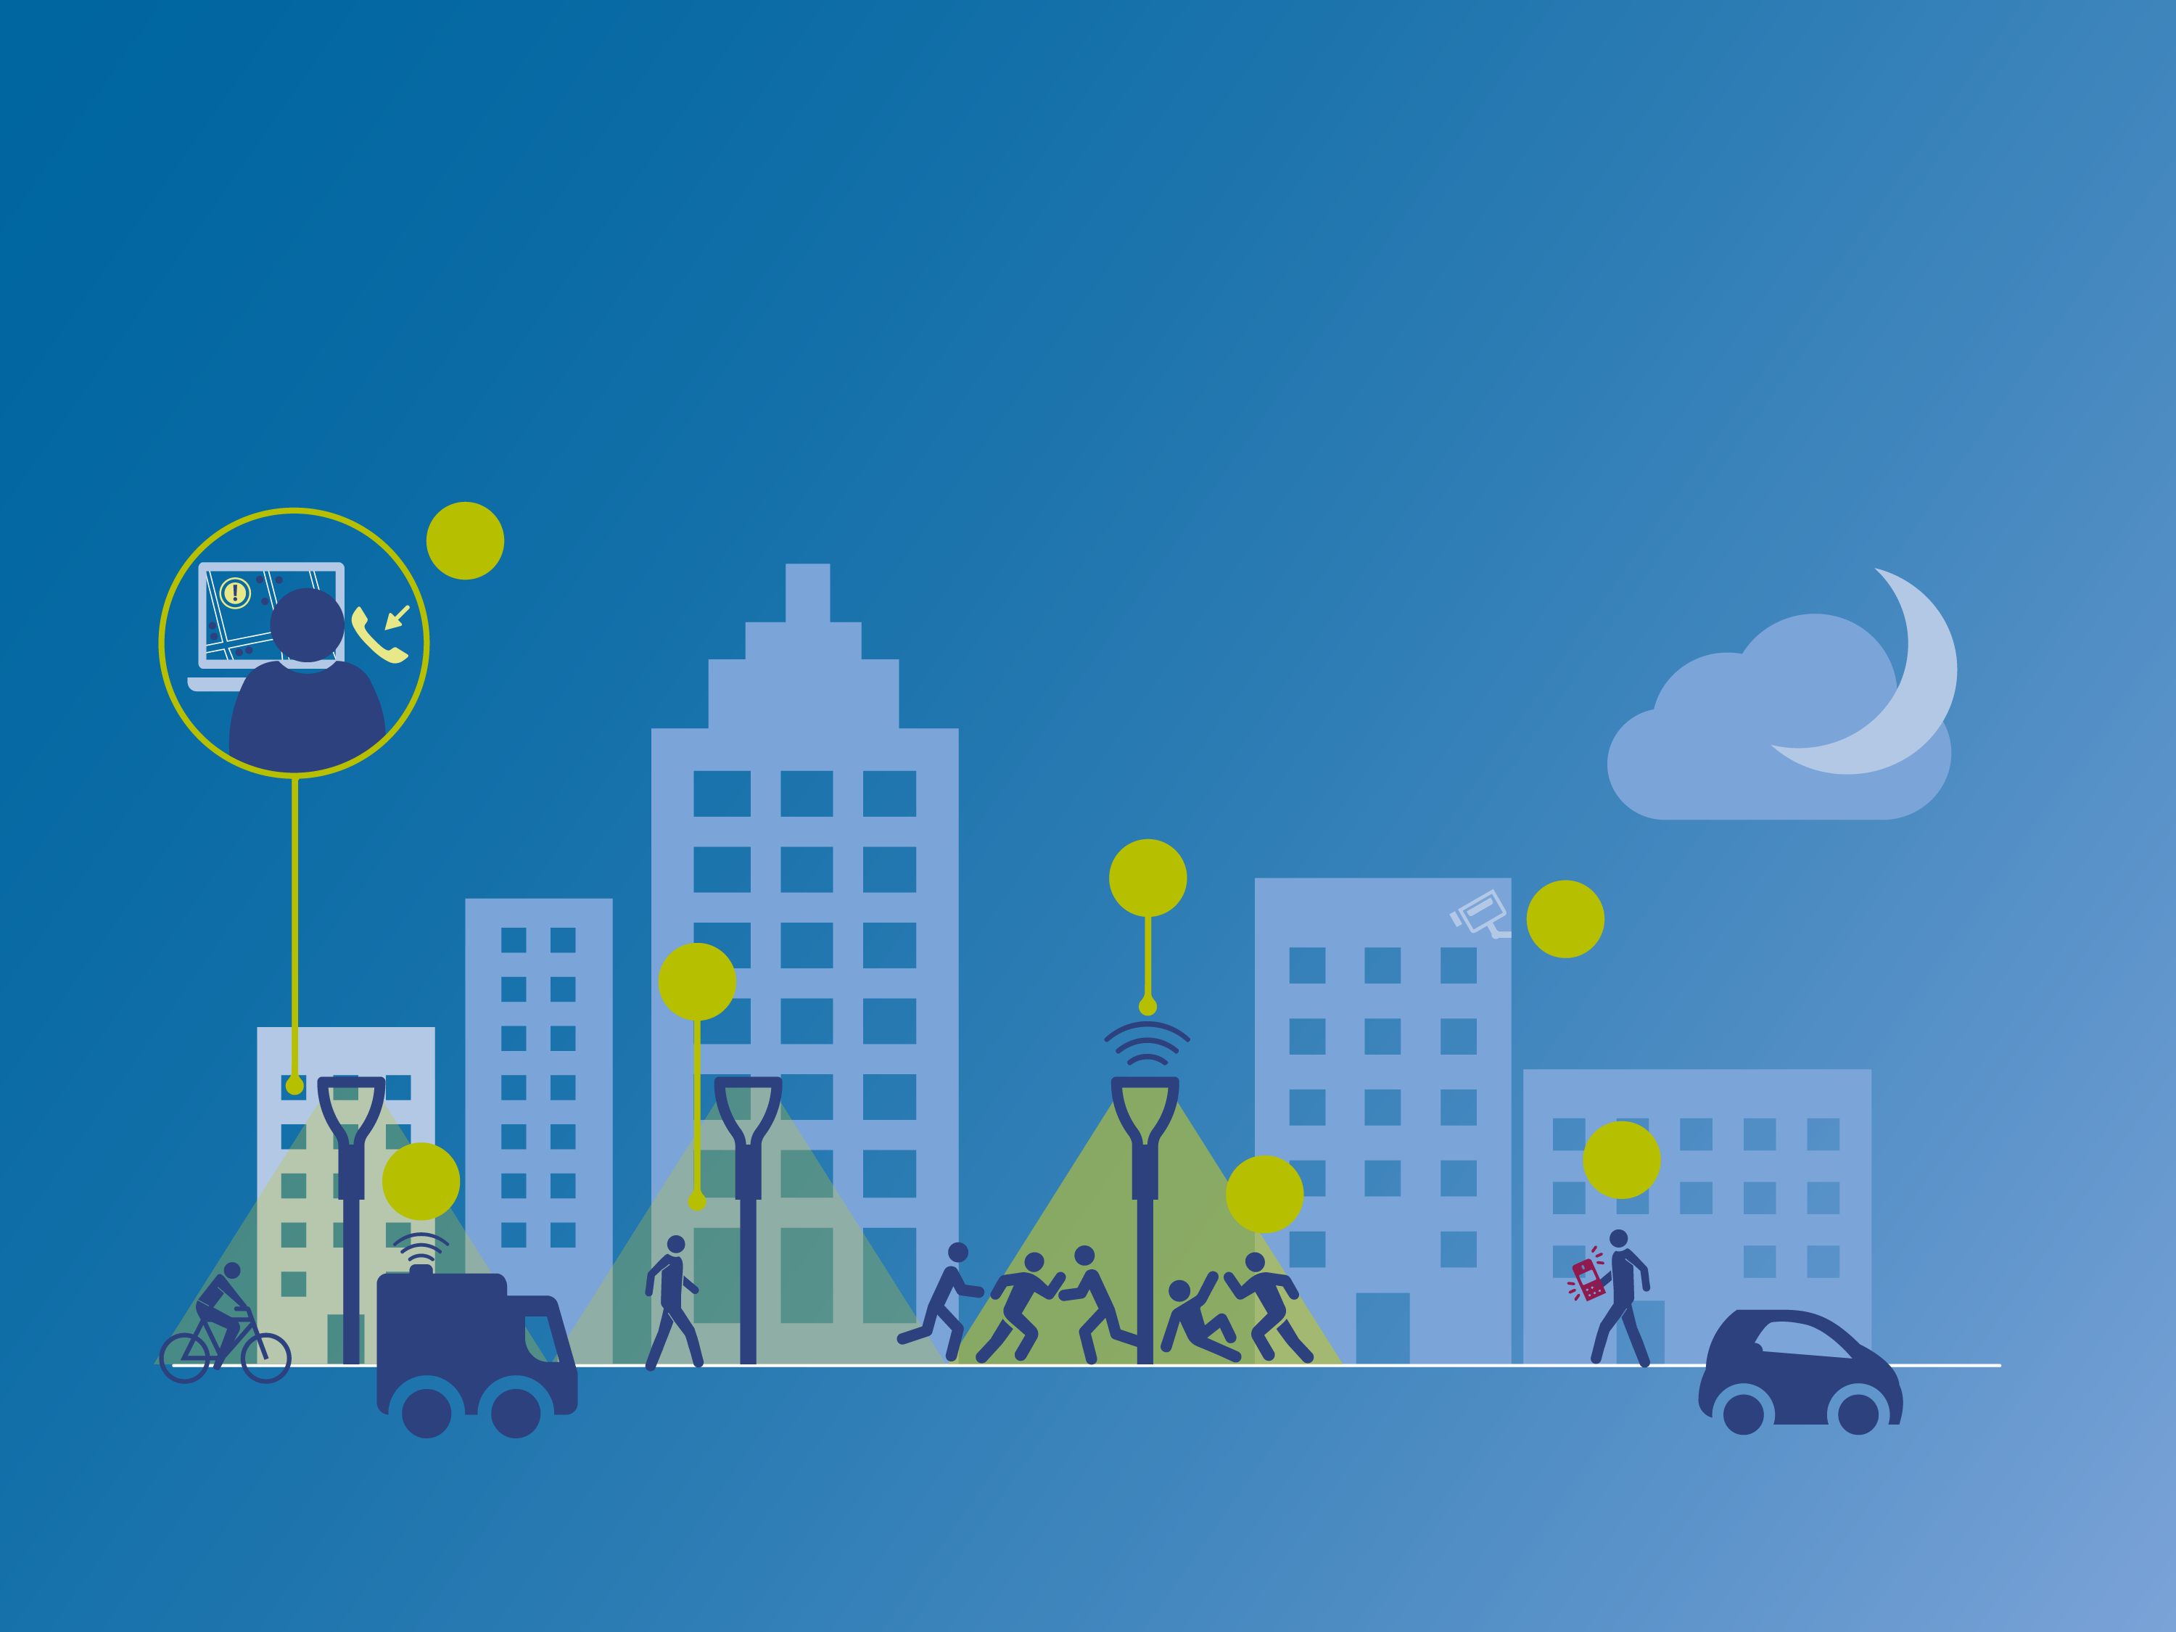

Connected lighting
and public safety
Individual
real-time control
4
Police control room operator overrides existing lighting scheme manually
Connected luminaire receives override call in real-time and delivers more light (100% instead of night dim)
5
7
Cameras produce better images
6
Police can respond better to incident
Large fight breaks out
3
Police responding
2
Incident is reported
to the police
1
Fast and better response to incidents by emergency services, Improved performance of security cameras
Adjustment to individual light poles while other luminaires stay dimmed to save energy

Slide 13
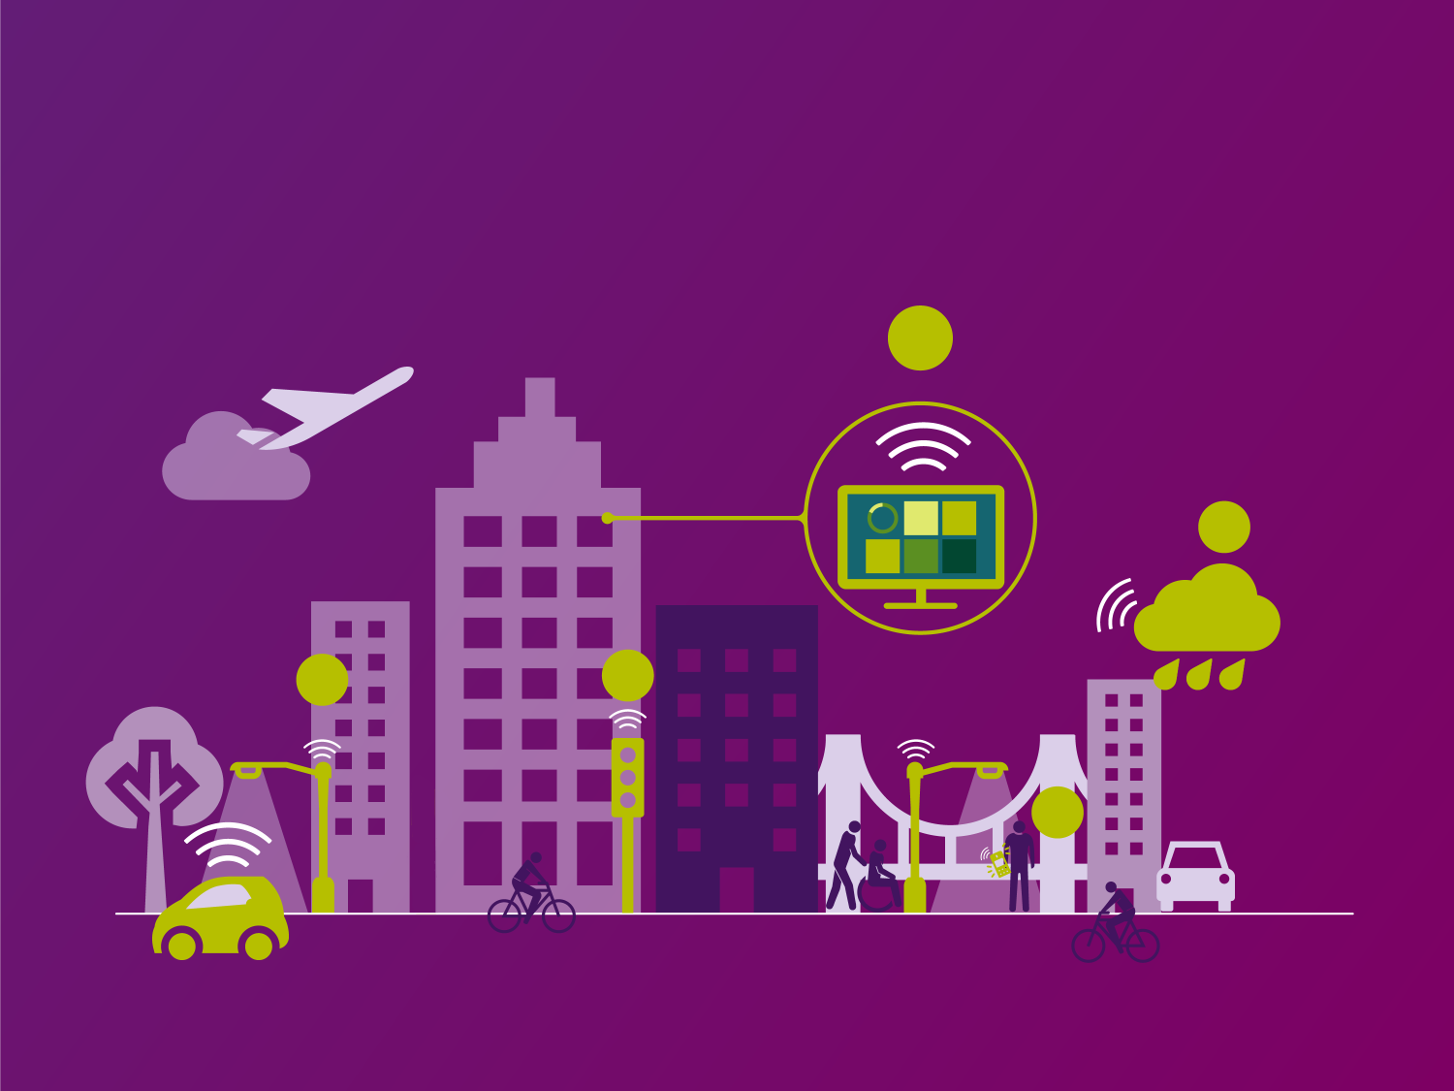
Exploring new value by
leveraging existing, ubiquitous infrastructure
5
Share and present insights via dashboards
Collect, analyze and aggregate data in the cloud
4
2
Environmental noise monitoring
3
Urban soundscape monitoring
1
Lighting network health monitoring

Slide 14

Evolving smart city applications
Responding to changing needs

Slide 15
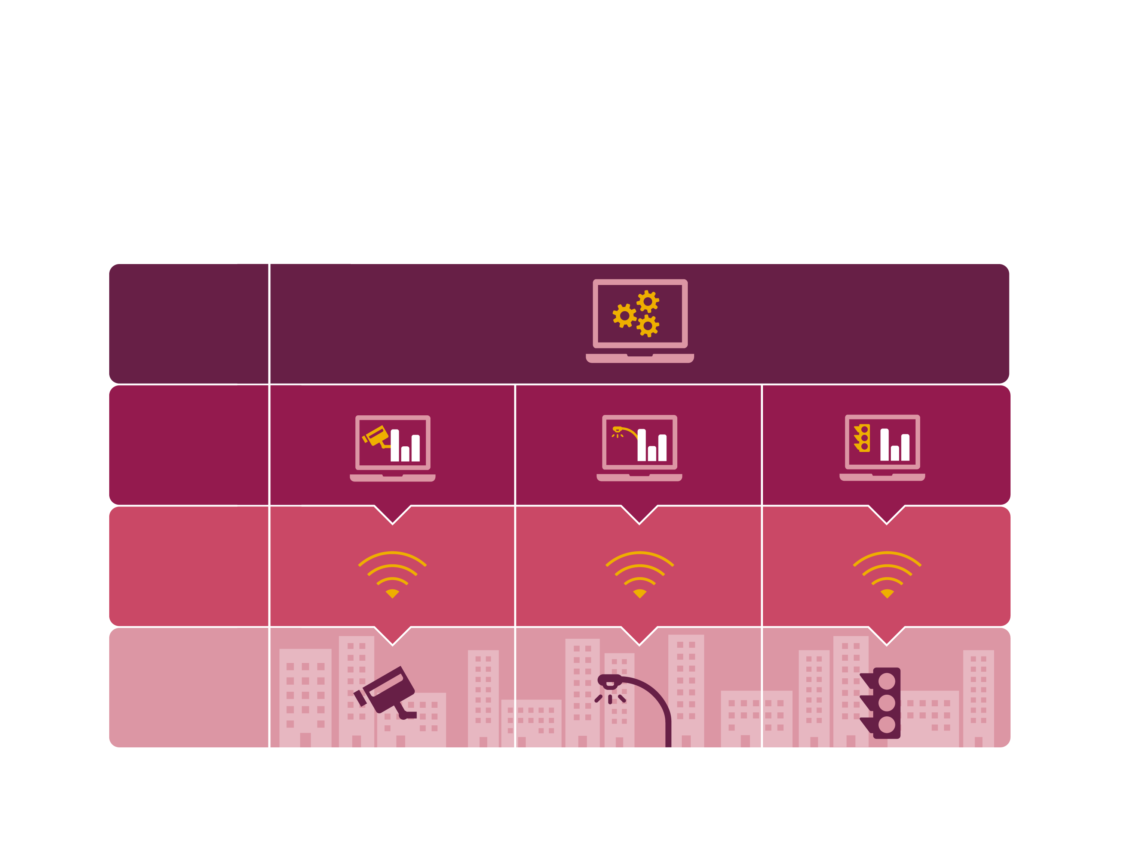
Expanding into smart city
use cases that provide new value
City asset management
/dashboard
Software level
Network level
Asset level

Slide 16
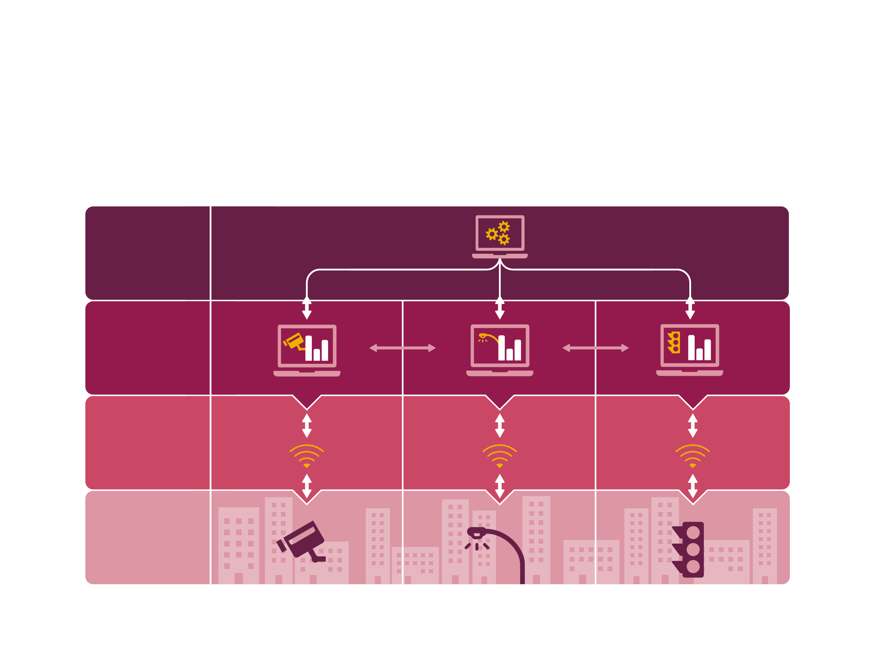
We enable new opportunities
via open, well-defined interfaces
City asset management
/dashboard
Software level
Network level
Asset level
Vision – Empowered cities with connected lighting
Location: TBC

